Slide 1
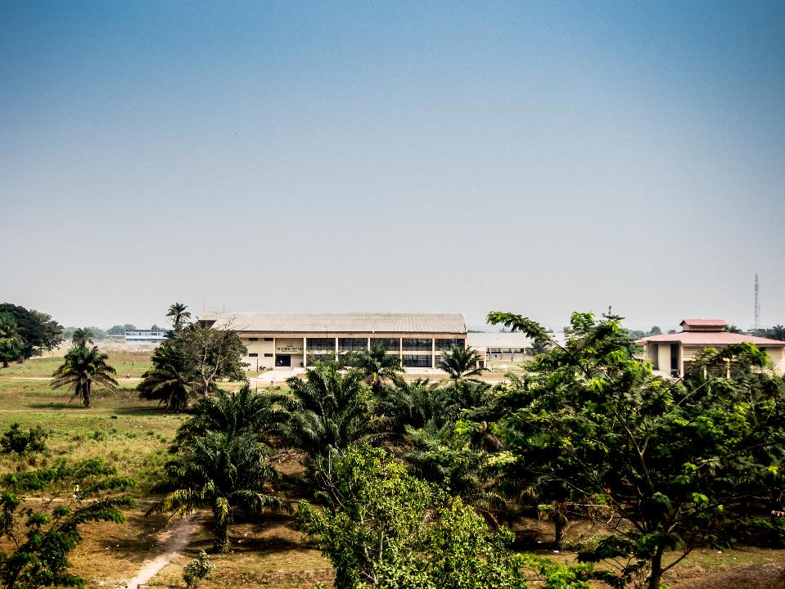
Congo event – IUC UNIKIS
Prof. dr. Johan Ackaert (coordinator IUC UNIKIS)
15 October 2019

Slide 2
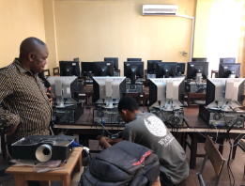
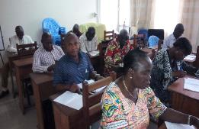
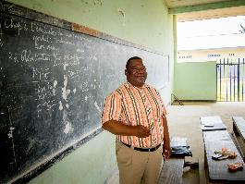
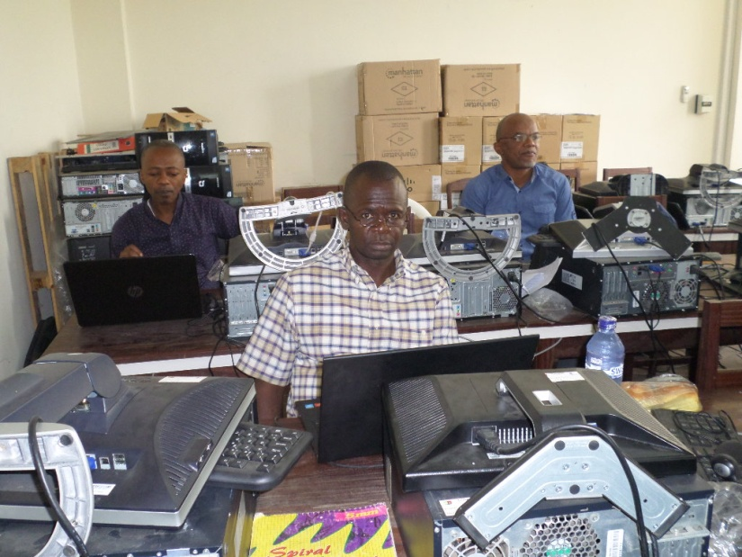
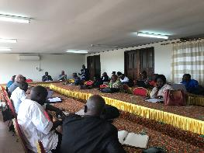
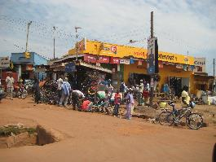
IUC University of Kisangani
Transversal project: institutional capacity building
IR2: academic English & French
IR1: ICT
IR3: pedagogy
IR4: administrative management
IR5: research coordination
IR6: interaction with the labour market
Notes:
Start of the programme: 2011
End of the programme: 31/12/2020
3 subprojects:
Sustainable agriculture
Biodiversity
Transversal project
Project 3: 6 Intermediate results
IR1: ICT: a lot of work has been accomplished (at the start almost nothing available at UNIKIS – pc’s by NGO Close The Gap)
IR2: Academic English & French: most of the work has been realized w.r.t. academic English (auto-evaluation & self study programmes -> same method can be used for academic French as well)
IR3: pedagogy: the research in this field is of high quality (Gratien Mokonzi) -> UNIKIS extended its network in this field (e.g. involvement in an EU Erasmus+ capacity building project related to evaluation)
IR4: administrative management: several processes have been digitalized
IR5: research coordination: since the third phase (important for the ownership) – e.g. in April 2019: a SWOT analysis has been made with the deans -> high ownership
IR6: interaction with the labour market: to do -> in the last year PA10 a survey will be conducted

Slide 3
Challenges/difficulties/weaknesses
Political and social context
Institutional embeddedness
Geographical location
Financial management
Transport of equipment
Identifying leadership
Notes:
- At the start of the programme, only involvement of faculty of sciences and agronomy -> with P3 (seminars of academic English, pedagogy) it has been widespread within the university, but this took some time
Political & social context
Geographical location makes it sometimes difficult to reach Kisangani (eg MONUSCO flights)
Transport of material/equipment is difficult
Financial management - Cash based economy: try to solve this issue with grantees/scholarship holders/fellows by transferring the scholarship directly to their bank accounts (instead of cash flows)
Identifying leadership (project leader) for the transversal project

Slide 4
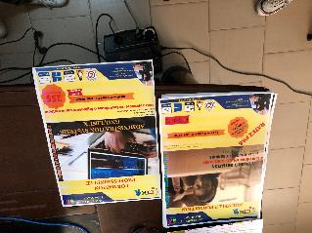
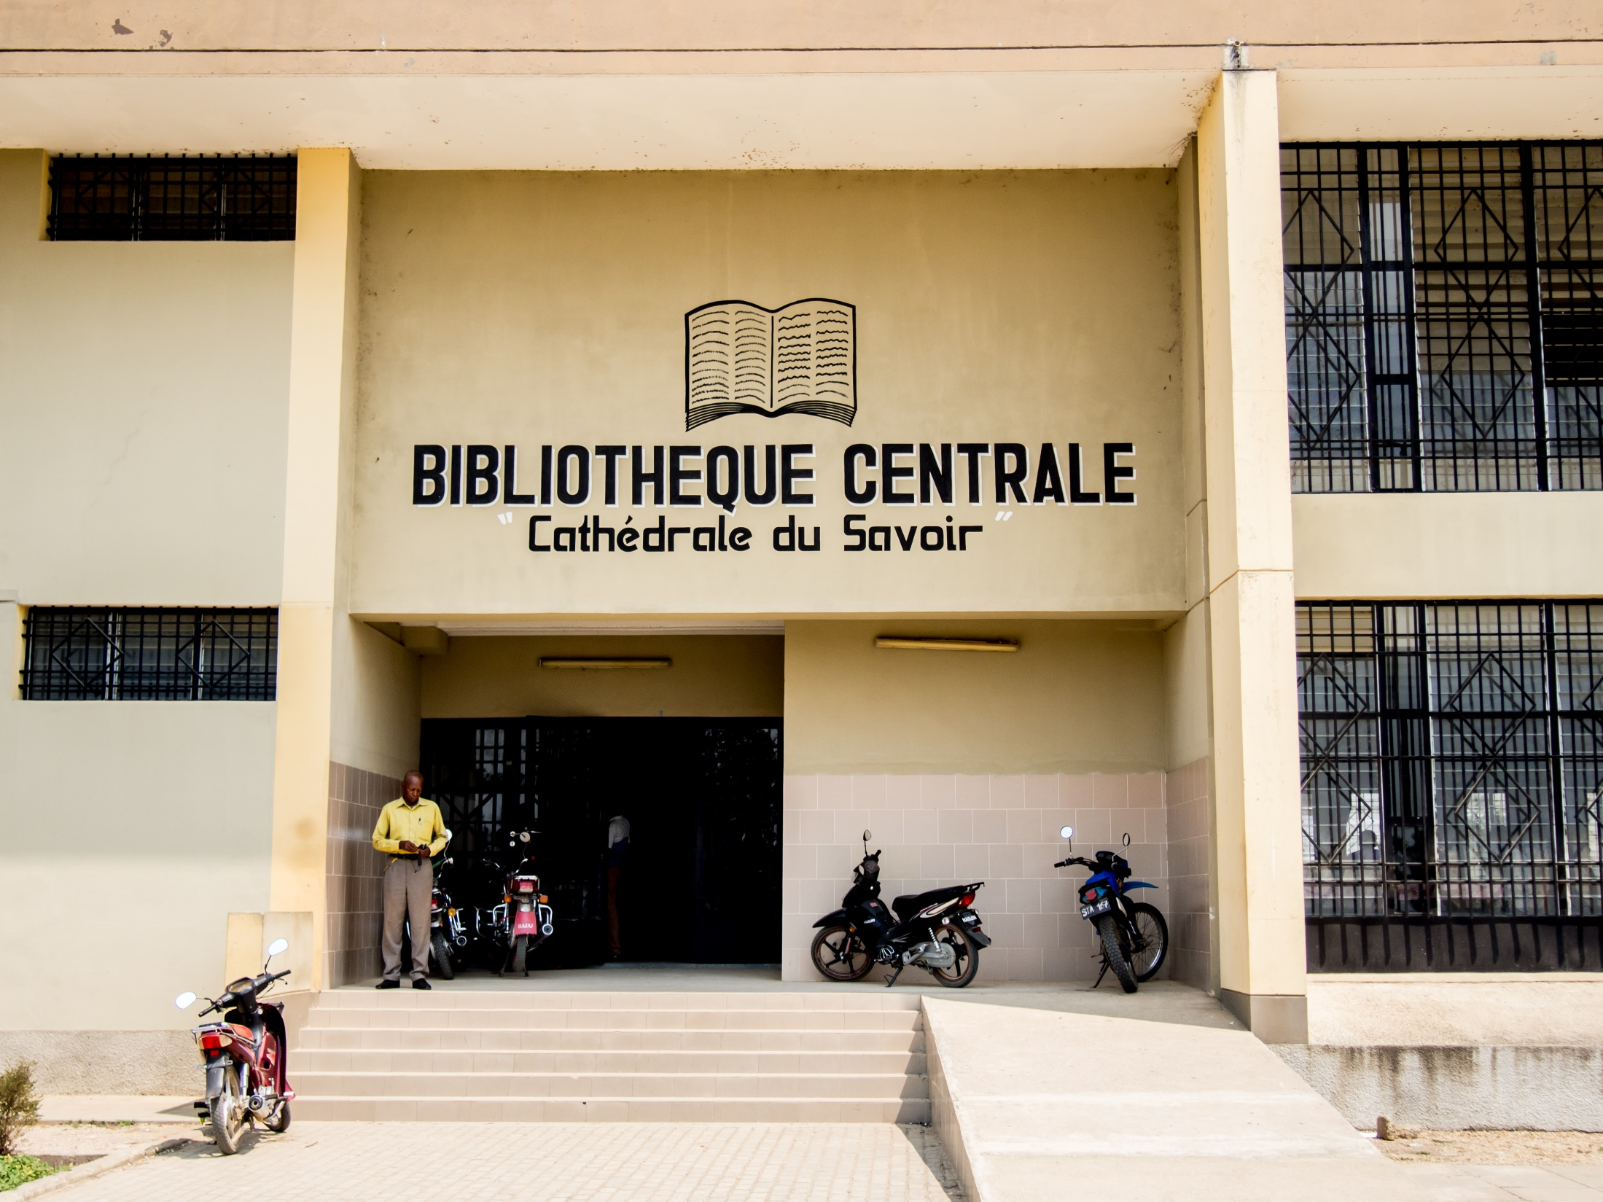
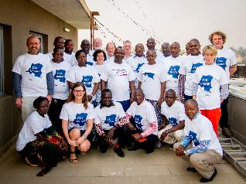
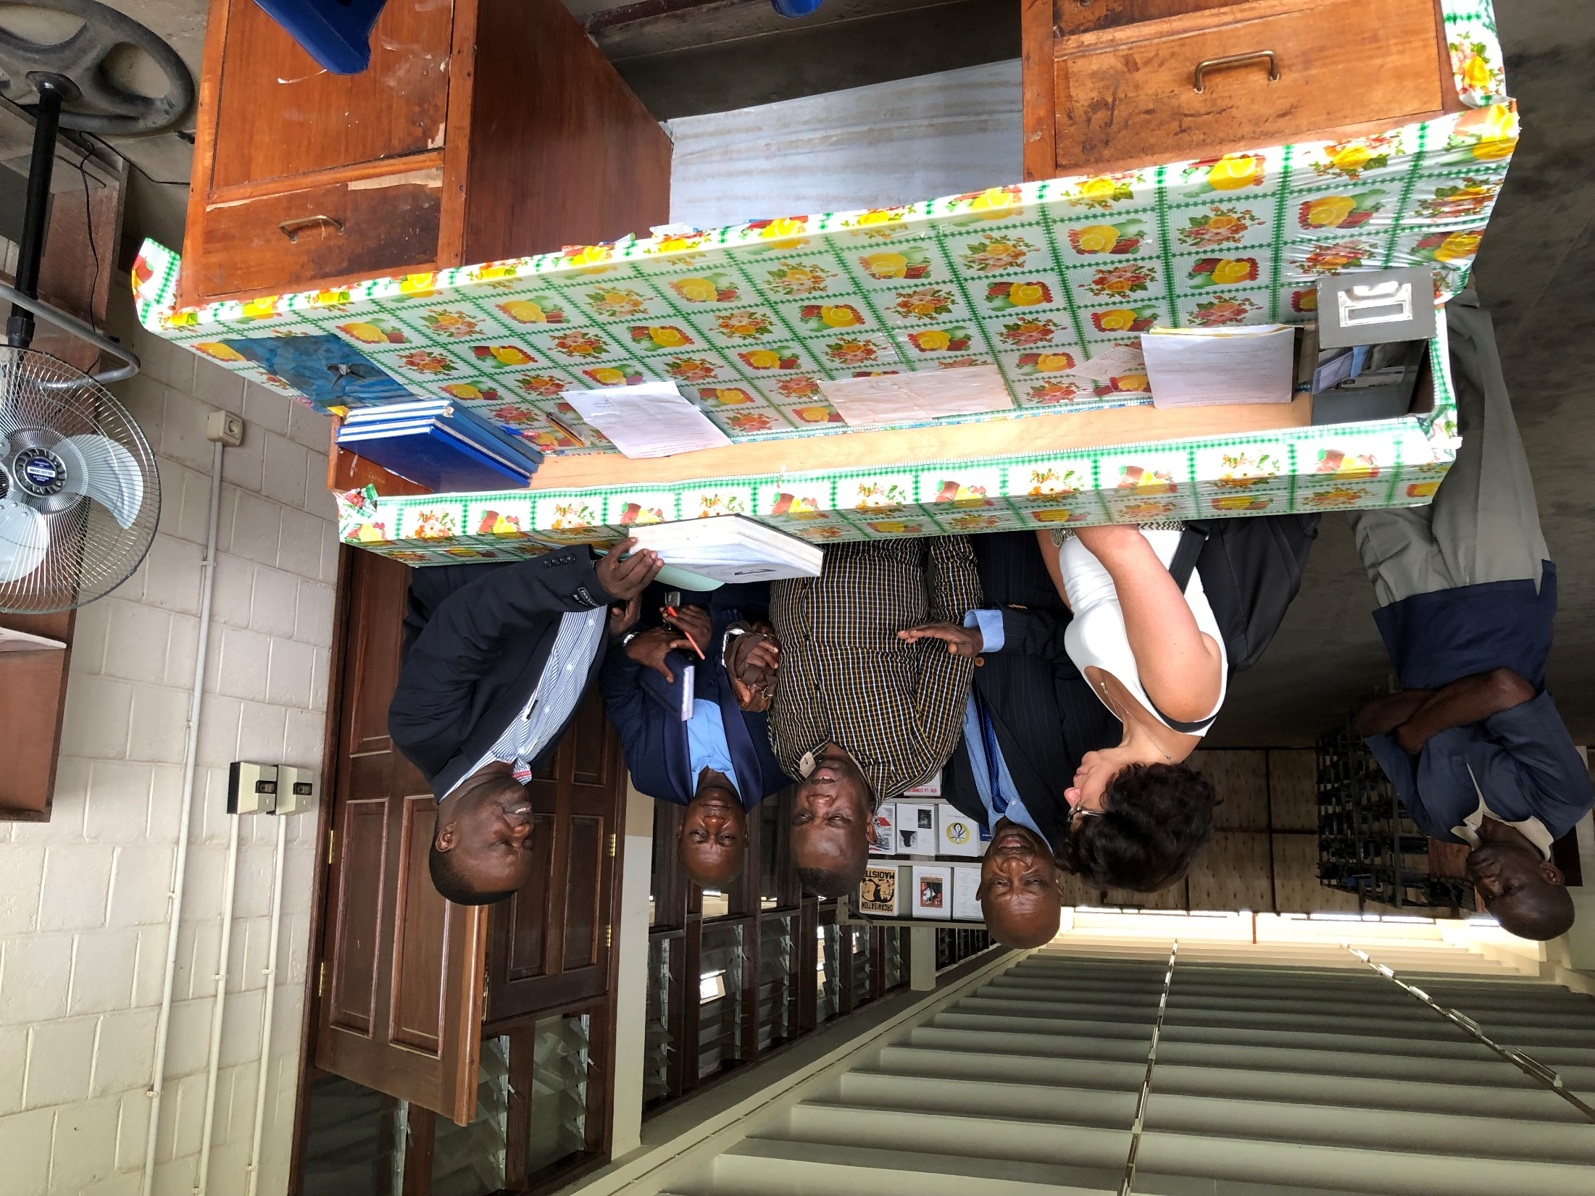
Successes/strengths
Opera-tionalisation of the Techno-logical Centre
Digitalisation of the library
Openness, trust and mutual respect
Ownership
Notes:
Technological Centre – generating own income
Digitalisation of the library: started from scratch (early stage: some difficulties with the online system, solutions were found to work offline and the work will be finished by the end of the programme)
Ownership has been increased (especially the last 2 years)

Slide 5
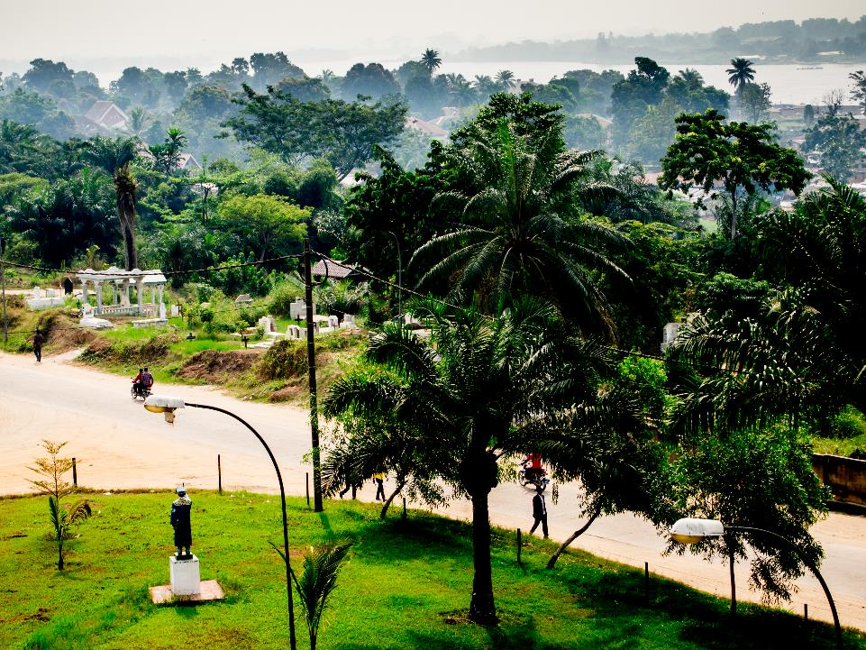
Lessons learned
Importance of the local context & culture
Multidisciplinary/holistic approach from the start
Emphasize institutional embeddedness from the beginning
Transfer ownership in early stage
Notes:
Importance of local context & culture (e.g. tribal influences / financial management)
Holistic approach from the start is important -> focus was too much on 2 domains (biodiversity & agronomy)
Institutional embeddedness: same rector for 8 years, successor is former project leader P1 and vice-rector of administrative affairs is team lid witin P3
Transfer ownership in early stage

