Slide 1
Connect4IUC /
VLIR-UOS in Vietnam
Christophe Goossens

Slide 2
What’s new?
2030 Agenda for Sustainable Development
Country strategy approach
→ SDG centred approach
SDG Principles:
Leaving No One Behind (LNOB)
Multistakeholder partnerships
Interconnectedness

Slide 3
What’s new?
Focus on connecting
Country Reference Frameworks
2030 Agenda
Higher education context
Other (Belgian) actors
Joint Strategic Frameworks (JSFs)
Thematic JSF HES4SD
Geographic JSF Tanzania
SharePoint tool (in development)
Notes:
The Country Reference Framework (CRF) for Tanzania supports teams of academics when identifying and formulating project proposals:
by providing a context analysis focused on Agenda 2030 on Sustainable Development and the higher education sector in Tanzania
and by providing an overview of Belgian development actors active in Tanzania, their ongoing projects and partners, in view of exploration of opportunities for synergy and complementarity.
Country Reference Frameworks as information/connecting hubs
Thematic JSF: higher education and science for sustainable development
SharePoint tool: connecting & exchanging between 5 new IUCs, later open to others

Slide 4
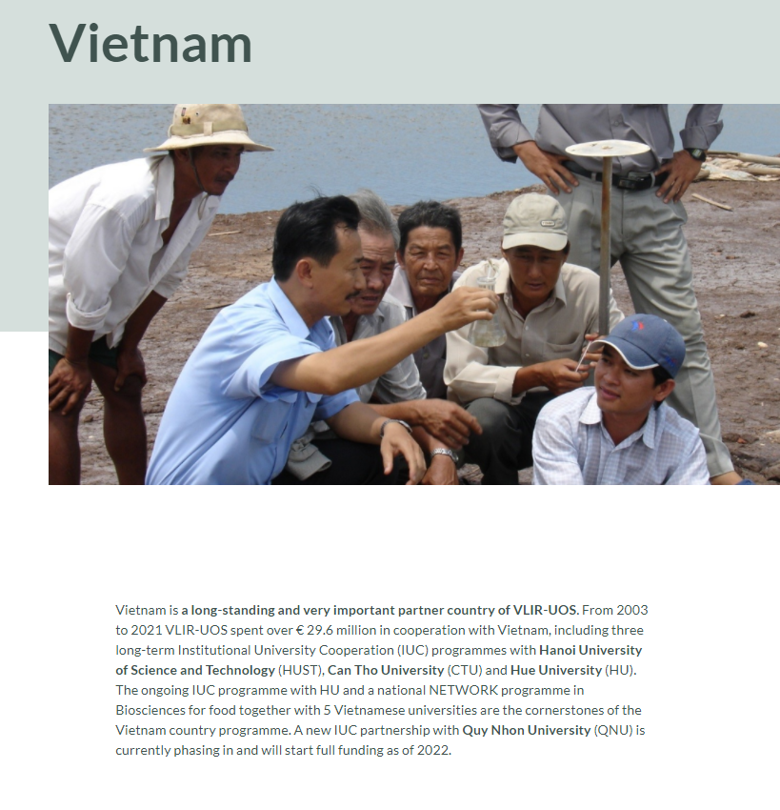
VLIR-UOS website
IUC Phase In QNU
Country page Vietnam
Sharepoint tool to connect: exchange with the 5 new IUCs, then to open to others: tool in development

Slide 5
How to connect with QNU?
For incoming team members or other interested parties:
Coordinators:
Vietnam coordinator: Vu Thi Ngan: vuthingan@qnu.edu.vn
Flemish coordinator: Kristiaan Temst: kristiaan.temst@kuleuven.be
Managers:
Vietnam manager: Nguyen Van Thang: nguyenvanthang@qnu.edu.vn
Flemish manager: Piet Wostyn: piet.wostyn@kuleuven.be

