Slide 1

Congo event
15 October 2019

Slide 2
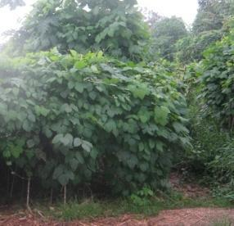
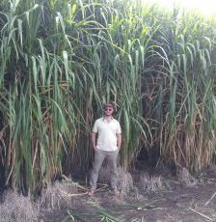
Agro-sylvo-pastoral reforestation and food security on peri-urbal strongly degraded lands (Kindu and Kisangani)
VlIR-JOINT UGent - UNIKI – UNIKIS Project
Promotors
UNIKIS: D. Pyame; UNIKI: P. Mobambo
UGent: G. Baert, G. Haesaert; ULg: J. Bogaert
Model used : ATV-system - cropping in plates under green carpet:
gramino-legume fallow
Strengthen food security, poverty alleviation and eco-social resilience (self-sustaining agro-forests) in areas affected by accelerated deforestation and soil degradation (Kindu, Kisangani).
Strengthen the agro-ecological expertise of the academic and scientific bodies of the UNIKIS and UNIKI for the benefit of students, farmers, NGOs and extension officers
Highlighting the great pluvio-radiative potential with flagship forage species such as Pennisetum purpureum, Albizzia chinensis and Mucuna pruriens
Mucuna pruriens
Pennisetum purpureum

Slide 3
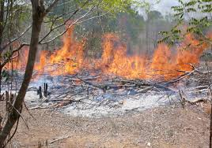
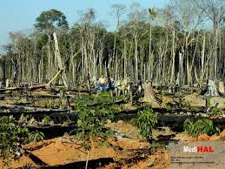
Challenges/difficulties/weaknesses
Farmers' attachment to slash and burn practices
Recurrence of weeds (7 weedings/year), invasion by Chromoleana odorata
Manual agro-ecological practices perceived as very labour intensive in manual cultivation: mini - mechanisation?
No integration of agriculture and livestock (manure)

Slide 4
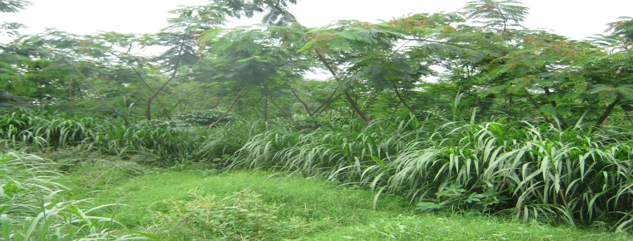
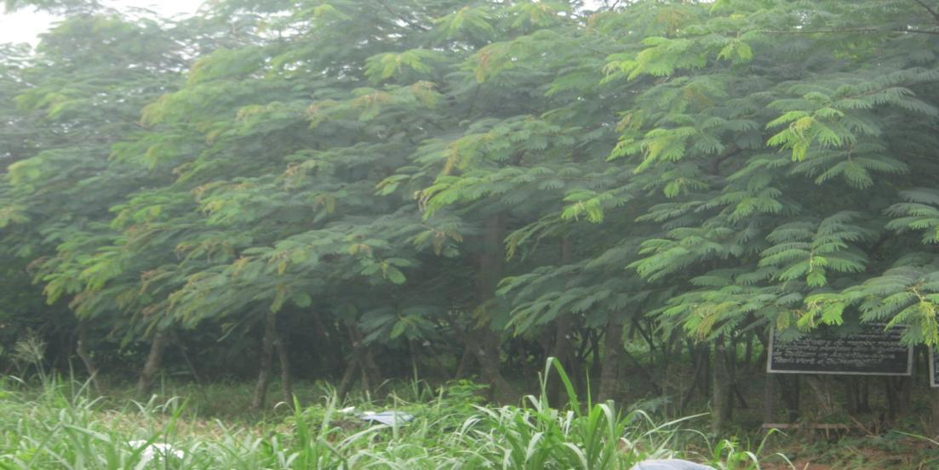
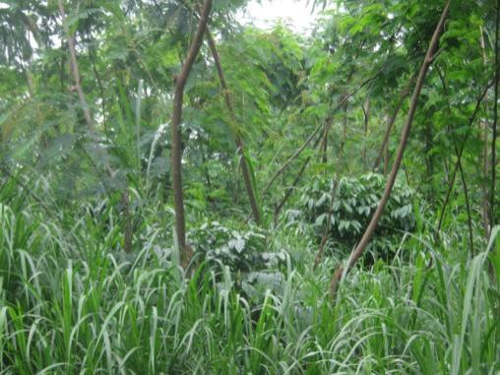
Successes/strengths
Use of the ATV system, with high biomass production potential
Strong suppression of weeds, in situ production of abundant biomass for conservation agriculture, livestock, composting, ….
Integrated agroforests with multiple benifits (agro-industry, wood...)
Potential substitute for traditional slash and burn shifting cultivation

Slide 5
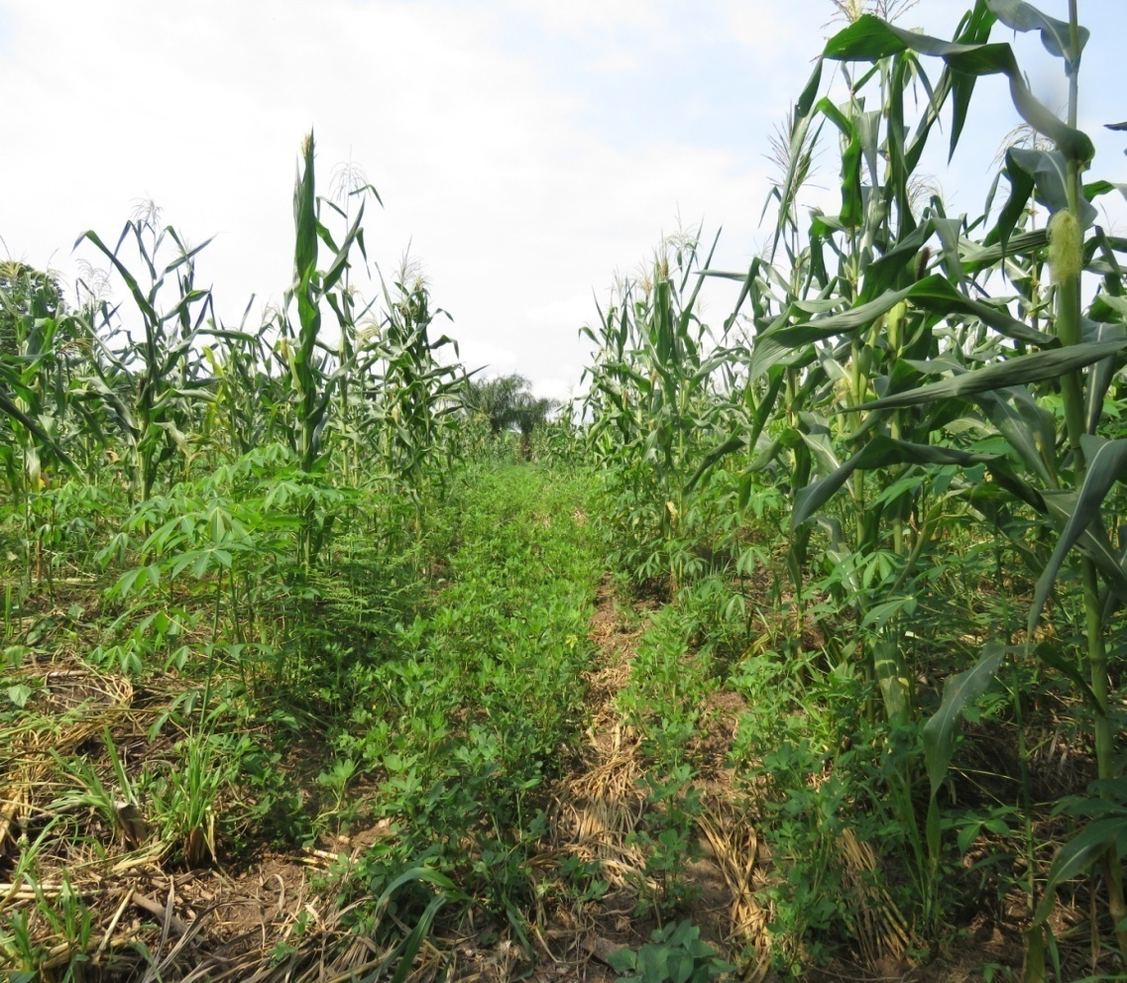
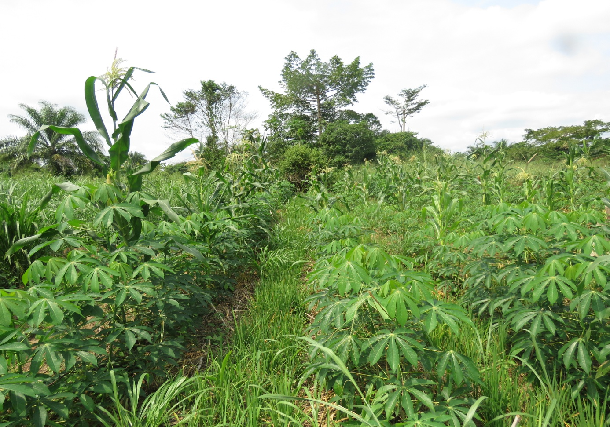
Lessons learned
Need to focus on agro-forestry training and participatory action research through ‘field’ schools (composting, demonstration fields, …)
Agro-sylvo-pastoral integration allows for high overall production, nutrient recycling / fertility maintenance, poverty alléviation
Mini-mechanization = facilitating agro-ecology

