Slide 1

ITP 2023
Project proposal formats and guidelines
Information session
30/03/22

Slide 2
Agenda
FYP2 ambitions what’s new
Intro to ITP 2023
New format for the ITP project proposals
Questions, clarifications & feedback

Slide 3
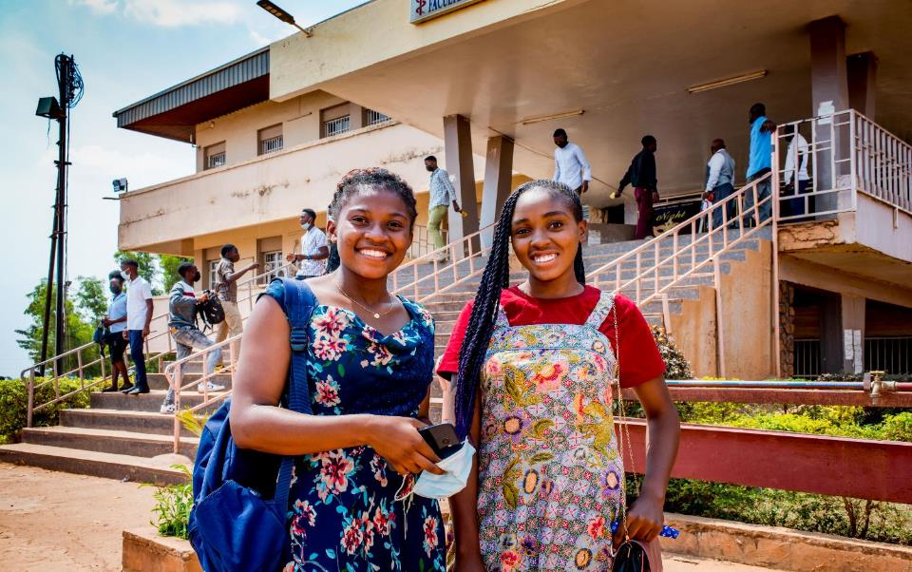


FYP2 ambitions and
what’s new?
Notes:
As we enter a new funding cycle with our donor, Five year programme , we have formulated new ambitions & priorities
Against the background of Covid-pandemic and lessons learned
Covid-19 changed the world drastically
So did we, in both private and professional life
Lessons learned from Covid-19
challenges are global : climate, sanitary crisis, …
solutions are global too
importance of research, data, evidence-based work
necessity of pooling knowledge and of global cooperation
importance of digital transformation

Slide 4

FYP2 ambitions
Higher education & science as levers for sustainable development and the realisation of Agenda 2030
3 priorities
Connect 4 change - Cooperation among and beyond academic actors
Valorisation - Scientific ánd societal impact
Collective learning - Data, lessons learned, sharing tips & tricks, platform
Notes:
Confirmation of role of HE
was developed and further translated into a Theory of Change (ToC) with a number of objectives and impact areas. The ToC clarifies what impact we want to contribute to and how and why VLIR-UOS and its portfolio is expected to achieve this intended impact.
SDG Principles:
Leaving No One Behind (LNOB)
Multistakeholder partnerships
Interconnectedness
Agenda 2030’ is used as the overall framework for the new VLIR-UOS Five-Year Programme (2022-2026).
Having an organizational ToC implies that all projects and programmes that are funded by VLIR-UOS have to match with this ToC (with at least one impact area and one outcome), including the ICP Connect projects.

Slide 5
Challenges and new priorities
  Main changes
  Agenda 2030 → mainstreaming the 3 SDG principles
  Incorporation of global citizenship education, decolonization & equal partnerships, and broader understanding of sustainable development into threefold mission
  Importance of themes
    Transversal themes : gender, environment
Notes:
Need for HES4SD
Higher education & science for sustainable development
are needed now more than ever
The overall context and Agenda 2030 have inspired us to revise our policy and conceptual framework, as well as how to organize HES4SD
Main changes
Agenda 2030 and SDG framework as main reference with the ambition to mainstreaming the 3 SDG principles throughout VLIR-UOS ambitions, policies, programme, portfolio, partnerships and scholarships
HE&SIs to incorporate global citizenship education, decolonization & equal partnerships, and broader understanding of sustainable development into threefold mission
Importance of themes
Switch from country based JSFs to thematic JSF
Transversal themes : gender, environment
Priority themes : decent work, human rights, D4D, decolonization, global citizenship

Slide 6
ITP: What’s new?
ITP’s => projects: focus on capacity building of professionals through short-term training
    Trainees becoming agents of change
    Their professional context as driver of change
Pre-training trajectory and followed by a post-training trajectory
Duration of 3 years max
Several editions, min. 8 scholars for each edition
Integration of Global Citizenship
Where & how: no fixed format
Max global budget per ITP: 150.000€ (training(s)+scholars)
Notes:
ITPs have become projects, which means they now follow a project logic with a focus on capacity building by funding short-term training. Now, activities in preparation of, during and in the follow-up of the training can be funded as well.
There is no fixed format anymore as to where and how to organise the training: ITPs can either be organised at a Flemish higher education institution, or in one of the 17 partner countries. Either online, in person, or a hybrid format.
Several editions of a training can be implemented during a project implementation period of maximum 3 years, benefitting at least 8 scholars.
The ITP project logic accommodates a maximum requestable budget of EUR 150,000, combining the training and scholars’ costs.
Integration of Global Citizenship in raising awareness around the link between the specific content of the ITP and the global challenges of the SDG’s
Agents of change stimulating their professional organisations to become drivers of change •Well defined strategies towards selection of trainees,including multi-stakeholder partnerships (rather than open

Slide 7
Timeline – ITP 2023
ITP - Proposals
Launch Call | 28 March 2022
Deadline submission | 4 July 2022​
Assessment Commission meeting | 1st week of September 2022​
Ratification of Assessment | End of September 2022​
Preparing contracts/start | September – December 2022​
Start ITP 2023 | 1 January 2023

Slide 8




What’s new?
2030 Agenda for Sustainable Development
New Theory of change (VLIR-UOS and per outcome)
Integration of transversal themes (environment, gender) and other priority themes
Country strategy approach
→ SDG centred approach
SDG Principles:
    Leaving No One Behind (LNOB)
    Multistakeholder partnerships
    Interconnectedness
Notes:
Agenda 2030’ is used as the overall framework for the new VLIR-UOS Five-Year Programme (2022-2026). A new VLIR-UOS vision, describing what contribution we want to make to Agenda 2030 through ‘Higher Education Partnerships for Sustainable Development’, was developed and further translated into a Theory of Change (ToC) with a number of objectives and impact areas. The ToC clarifies what impact we want to contribute to and how and why VLIR-UOS and its portfolio is expected to achieve this intended impact. The underlying principles of Agenda 2030 (‘Leaving no one behind & inclusiveness’, ‘Interconnectedness & indivisibility’ and ‘Multi-stakeholder partnerships’) are used to render the VLIR-UOS portfolio and all activities, results and impact ‘SDG proof’. Having an organizational ToC implies that all projects and programmes that are funded by VLIR-UOS have to match with this ToC (with at least one impact area and one outcome), including the ICP Connect projects.
It is now an outcome based programme and no longer country based. ITP forms part of the Education Scholarships and Networks outcome
Country strategy approach is replaced by an SDG centred Approach
There is synergy & Complementarity through the Thematic Joint Strategic Framework with ARES and ITM on Higher Education and Science for Sustainable Development with attention for transversal (gender, environment) & priority themes of Belgian Development cooperation
Collective learning trajectories with ARES and ITM on scholarships, gender, global citizenship, decolonization

Slide 9
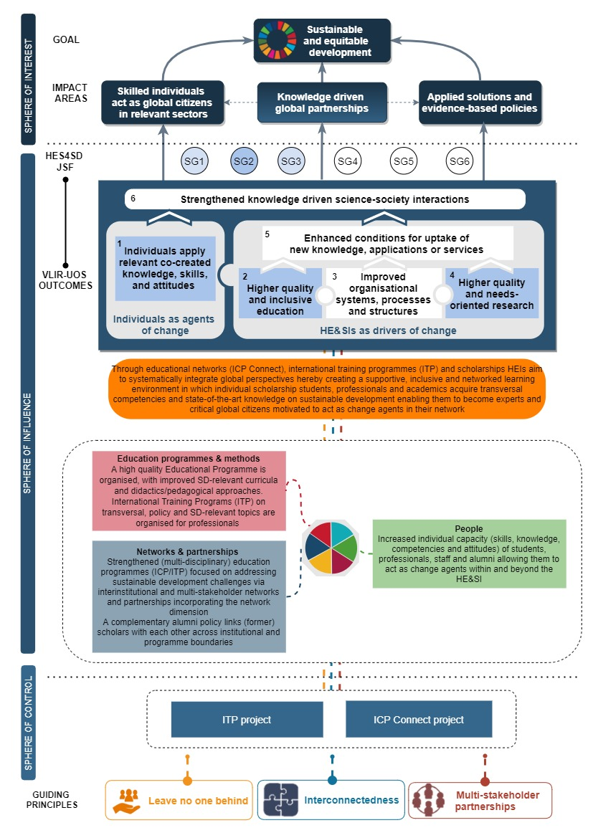
1 goal
3 impact areas
6 strategic goals JSF HES4SD
6 VLIR-UOS outcomes along 2 axes:
Individuals as agents of change
HEIs as driver of change
6 project change domains
VLIR-UOS
Revised Theory of Change
Notes:
The SDG principles serve as a compass in VLIR-UOS endeavour of sharing minds, changing lives. As visualised in the ToC, they are transversally integrated to render the activities and change processes SDG-proof.
VLIR-UOS considers global engagement for higher education as a goal (SDG 4: Quality Education) and a means for attaining other SDGs through knowledge co-creation, transfer and valorisation. In the long run, ICP is expected to contribute to more sustainable and equitable development due to its potential to foster:
Application of solutions and evidence-based policies
A global community of skilled individuals who act as global citizens in relevant sectors
Knowledge-driven global partnerships
The first impact area relates to the role of higher education in contributing to innovation and the valorisation and application of new knowledge, insights and evidence for sustainable development.
The second impact area aligns with the evidence provided in the UN Global Sustainability report 2019, which highlights the potential of HEIs to develop through their teaching generations of new leaders and skilled professionals for sustainable development.
The third impact area draws upon the idea that reciprocal partnerships are essential in safeguarding knowledge co-creation, exchange and uptake within and beyond the scope of the supported interventions. This final impact area also matches the ITP concept, as ITP projects enable the development/strengthening of networks of professionals in various sectors, academia, etc. thereby unleashing the full potential of partnerships.
Thus besides the above, individual projects may choose to focus on a sub-selection depending on priorities and needs of local stakeholders. Yet, projects are required to document their choices through their project-specific Theory of Change to ensure alignment with the programme’s vision towards change.
VLIR-UOS outcomes (1) Individuals apply relevant co-created knowledge, skills, and attitudes, (2) HEIs provide higher quality and more inclusive education and (4) HEIs conduct higher quality and needs-oriented research.

Slide 10
Notes:
An ITP project can focus on different project domains (=domains of intermediate change) that contribute to the different outcomes, with ‘Education programme and methods’, ‘People’ and ‘Networks and partnerships’ being the main ones. It is possible that ITP projects focus on one or more of the other project domains (outreach and policy support; research programmes and methods; systems, policies and infrastructure) and if this is the case, promoters are invited to clarify their focus on one of these additional domains. The most important changes, resulting from ITP projects and examples of deliverables for these three domains, are outlined in the table below. It presents a non-exhaustive and indicative list of deliverables and activities that individual projects can undertake. The deliverables, processes and changes in these domains are interlinked and not mutually exclusive.
People: Students, alumni, staff, researchers are trained/sensitised in a supportive learning environment to strengthen their knowledge, skills & attitudes in diverse domains (e.g. leadership, global citizenship).
Education programmes and methods: Improved, innovative and inclusive teaching methods, didactics, and digital approaches. Improved curriculum content to support knowledge co-creation and equip students with the necessary skills and knowledge ensuring their career development after the training and ability to tackle global challenges from a holistic and interdisciplinary perspective.
Networks and partnerships: Strengthened interactions within reciprocal partnerships and engagements at local, regional and global levels between HE&SIs, researchers, staff, students and other stakeholders in society (public actors, private actors, other CSOs, communities, etc.) for sustainable development

Slide 11
Target groups
Define target groups
Define recruitment strategy
Define selection procedure
Notes:
The precise target group(s) (and criteria) aimed at by the applying promoter needs to be specified in the application, together with preliminary information on the possible participants and a description of the recruitment strategies that will be used
The ITP project is responsible for the organisation of the application and selection of the participants and of the scholarship candidates by defining a selection procedure

Slide 12
Points of attention
Target groups: professionals
A 40-60% balance between male and female
No age limitations for participants
Reasonable cross-section of trainees from different countries and regions
Attention for vulnerable groups
‘Leave no one behind’ principle, we want to give as many new applicants as possible a chance to receive a scholarship
Notes:
The target group of ITP are professionals from civil society, private or public sector and/or academics, scientists, researchers at HEI with relevant professional experience in the subject of the organised ITP
A 40-60% balance between male and female candidates awarded ITP scholarships
There is no formal limit on the number of VLIR-UOS scholarships one person can receive. However, based on the ‘Leave no one behind’ principle, we want to give as many new applicants (not having received earlier VLIR-UOS scholarships) as possible a chance to receive a scholarship

Slide 13
Eligibility of countries
17 project partner countries:
Africa: Benin, Burundi, DR Congo, Ethiopia, Kenya, Morocco, Rwanda, South Africa, Tanzania, Uganda
Latin America: Bolivia, Cuba, Ecuador, Peru
Asia: Indonesia, Philippines, Vietnam
Notes:
Small expenses for activities in non-VLIR-UOS partner countries (e.g. a field trip) can be allowed if these remain limited and fit the finality of the ITP project.

Slide 14
Eligibility of scholars
Scholarship candidates have to be a national and resident of one of the VLIR-UOS scholarship countries.
OR an employee of a target organisation (HEI, NGO, SME, …) in one of the 17 VLIR-UOS partner countries (candidates exceptionally can have a different nationality, but this should be a minority)
VLIR-UOS scholarship country list 2022-2027 (29):
Africa: Benin, Burkina Faso, Burundi, Cameroun, DR Congo, Ethiopia, Guinea, Kenya, Madagascar, Morocco, Mozambique, Niger, Rwanda, Senegal, South Africa, Tanzania, Uganda, Zimbabwe
Asia: Cambodia, Indonesia, Palestine, Philippines, Vietnam
Latin America: Bolivia, Cuba, Ecuador, Haiti, Nicaragua, Peru
Notes:
a national and resident of one of the VLIR-UOS scholarship countries
OR an employee of a target organisation (HEI, NGO, SME, …) in one of the 17 VLIR-UOS partner countries (candidates can have a different nationality, needs to be an exception)

Slide 15
Questions? Feedback? Concerns?

Slide 16

How to use the formats?

Slide 17



FYP2: 2022-2026 Connect4Change :
New formats and guidelines
Taking into account the new SDG framework (sustainable development context, Theory of Change per Outcome, SDG principles)
Revised theory of change aligned with Agenda 2030 & SDG principles
Formats and guidelines: standardisation, simplification, digitization via a new modular approach
    Less text, documents, annexes
    Online environment
    Working documents for exchange/preparing (word/excel)
    Avoiding duplication
Scholarship & financial guidelines being updated
Notes:
Education is considered both a goal in itself (SDG 4: Quality Education) and a means for attaining other SDGs. There is no selection of specific SDGs that ICP Connect projects can contribute to as in principle they can contribute to all SDGs in different ways by e.g. supporting students to become change agents in specific areas, by supporting research in certain areas, by building networks with other HEI on specific topics worldwide, by supporting more inclusive educational practices…
The new formats and guidelines will be standardized, simplified and digitized through a modular approach

Slide 18



Support & guidance offered
Formulation guidelines with background information on how to fill out the format & checklist for integrating SDG principles per module (based on SDGs as a compass toolkit)
Online form connected to database / website for calls
Formats (working doc):
  Excel template for Summary, Module 2, 3, 5, 7
  Word template for “narrative” questions / outline for online inclusion of information
Information package (under development) with slides summarizing essential info
Notes:
We are offering support and guidance while filling in the documents.
Formulation guidelines on how to fill out the format including a checklist for integrating the SDG principles Leave No One Behind, Interconnectedness & indivisibility and Multi-stakeholder partnerships.
You will need to fill out two types of documents, excel and word for the narrative questions
We are developing an online environment to be used as a tool which will simplify the submission of your formats, to switch between the modules. This tool can then be used not only for planning, but also for reporting.

Slide 19
Content: 8 modules + summary
Format
Pages of text
1: Context analysis
2: ToC and strategy
3: Organisation
4: Stakeholders and coherence
5: Planning & budgeting
(6: Risk management)
7: Monitoring & reporting
8: Learning and steering
1
5,5
0,5
1,5
0,5
-
-
0,5
Notes:
The format contains 8 modules, in this overview you can see when to use the word format or the excel document per module, and the amount of text that needs to be filled in (total of 9 pages). You can switch between the modules, no sequential order needs to be followed, however this will help you with filling out the format since you will notice that some of the modules are linked to each other.
for example, based on the context analysis in Module 1 a theory of change is formulated in Module 2. Finally, the modules will make it possible in an online environment to be used as a tool not only for planning, but also for reporting whereby switching between modules will be possible in a swift manner.

Slide 20

Context analysis
Module 1
1. Sustainable development context
2. Individual and organisational capacity building context
Notes:
Describe the key sustainable development problem(s)/ developmental challenge(s) that the ITP project wants to tackle and its global/regional/local contexts and how it links with Agenda 2030 and the Sustainable Development Goals (SDGs).
Individual and organizational capacity constraints; describe how trainees can become an agent (individual) of change and how their professional environment can become a driver of change (organisational)
Conditions for ownership and mutual capacity building!!

Slide 21

Theory of Change (ToC) & strategy
Module 2
1. Change narrative
2. Project strategy
ESSENCE
Envision the desired long-term change (dream) to which the project wants to contribute. Describe and visualise change pathways to develop an impact-oriented strategy with concrete activities and deliverables in the selected project change domains.

Slide 22
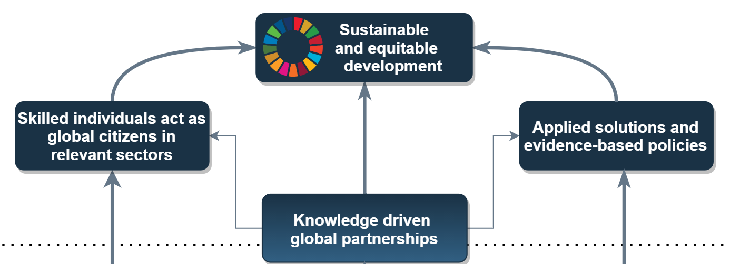

Impact statement = project vision
Module 2
Key questions
1) What are the ambitions / dreams of the project (= long-term change)? Why and for who?
Max. 500 characters – in excel
Sustainable development (SD) impact
Institutional (partner HEI) impact
Notes:
VLIR-UOS projects are expected to contribute to sustainable and equitable development in society. The first step is to concretise how your project will contribute to sustainable and equitable development. This fits under the impact statement section in the excel format. The impact statement should briefly describe the long-term change (=impact) to which the project wishes to contribute. This cannot be modified once the project has started.
Impacts = positive and negative, primary and secondary long-term effects produced by a development intervention, directly or indirectly, intended or unintended (OECD-DAC).
This first step builds further or runs in parallel with the context analysis and allows to brainstorm and envision what the dream of the proposed project is, in line with local priorities and the local institutional context. The desired long-term change should be challenging and ambitious, but not impossible to achieve (reachable in 15 years’ time; the project only contributes). Identify if and how you can ensure synergy and complementarity with other actors with other (Belgian) actors as much as possible in the light of synergy and complementarity.
Visualise the ultimate desired change or ‘dream’ in a time perspective of 10-15 years and make sure that the desired change is as concretely as possible:
Who should benefit from the desired change / dream? Will the dream impact differently on certain groups (gender, age, ethnicity, etc.)?
What will have changed?
Where will the change happen?
How this change can be realised forms part of the different pathways “theorizing” the change. Such a theory of change will be further developed throughout this module and translated into a project strategy with concrete deliverables / activities (=theory of action, for VLIR-UOS project translated into 6 standard (project) domains of intermediate change).

Slide 23
Developing a change narrative
Module 2
Narrative description of the change process / pathways and assumptions
Here you can explain the content and the strategy of your ITP project. Develop a change narrative which serves as a compass for the project strategy. This narrative description of the change process should build further on the context analysis of Module 1 and should align itself on the VLIR-UOS ToC.
Notes:
A compass for the project strategy. This narrative description of the change process should build further on the context analysis of Module 1
It explains the flow between:
To describe the change process you should explain the flow between: The sustainable development related objective or dream (=impact) to which the ITP wishes to contribute (in line with Agenda 2030 and the SDGs), the outcome(s) the project can realistically achieve (by aligning with the standard VLIR-UOS outcome areas) and the expected intermediate changes linked to one or more of the six standard VLIR-UOS project domains. In summary: this description clarifies why this proposal is important, what you hope to achieve, and what the project will do, while also indicating its alignment with the VLIR-UOS ToC. When elaborating, the most important uncertainties / assumptions/risks related to the change process should be identified as well

Slide 24
Methodology and specific project strategies
Module 2
Key questions
Methodological approach: methodologies to realise changes, indicate what is creative and innovative (incl innovative pedagogic methods and approaches),target group definition, recruitment strategy, selection procedure, scholarship policy
Project priorities in terms of the transversal themes gender, environment, global citizenship in the project strategy
Notes:
Methodology to realise the envisioned changes at project level
Integrating approaches regarding global citizenship, Agenda 2030 and SDG principles and describing your scholarship and alumni strategy and your environmental priorities.
Project priorities on how to integrate gender: What will the project do to fix the numbers, fix the organisation, fix the content as explained in our gender policy

Slide 25

Organisation
Module 3
1. Who is involved?
2. How is the project structured/organised?
Notes:
In who is involved you need to mention your partner institutions for the ICP Connect project and if you have collaborated previously. Here the project team, promotor, co-promotor, coordinator and other team members together with their experience and contribution to the project are specified, at the Flemish and at the partner institution.
The roles / responsibilities of each partner and how the project is governed, the partners’s role in the development of this proposal and their future role in the implementation, as well as the balanced task division among the involved partners need to be mentioned
How the project will implemented (including communication strategy and selection modalities) and how applicants from the VLIR-UOS country list will be reached has to be mentioned too.

Slide 26

Stakeholders
Module 4
Identification, management & engagement strategy
Coherence: internal & external
ESSENCE
Describe and analyse the internal and external stakeholders that will be involved in or will benefit from the project. How will they be involved and their interest/influence.
Notes:
The key stakeholders that will be involved in or will benefit from the project. These include both internal (inside HEI, but external to the project partners) and external (outside HEI) stakeholders, and direct and indirect beneficiaries.

Slide 27
Coherence
Module 4
Key questions
What synergies or complementarities are foreseen with…
1) External:
  Projects/academic programmes/networks with external funding? (cfr questions/proposals from ANGs!)
  The local/regional context?
2) Internal:
  with other VLIR-UOS funded projects / activities in line with the needs of (in)direct beneficiaries and local partners’ priorities?
Max. 1 page
Notes:
Describe how synergies and complementarities with projects/academic programmes/networks not funded by VLIR-UOS will be created.
In addition, describe how the proposed project will promote synergies or complementarities with local/regional context.
Describe how synergies or complementarities with other VLIR-UOS-funded projects/activities will be facilitated in line with the needs of the direct and indirect beneficiaries (students, partner organisations, alumni, public/private/civil actors) and with the local partners‘ priorities.

Slide 28

Monitoring & reporting
Module 7
Standard indicators

Slide 29

Planning and budgeting
Module 5
ESSENCE
Word: Elaborate a narrative on your budget. Motivate the requested total amount. Elaborate on how much will be spent on the different activities and why you choose this repartition.
Excel:…
Notes:
The operational plan includes the specific activities per project domain over the activity years. It specifies what activities must be done to achieve particular goals, when they need to be done and who is going to do them. It includes both the outputs that need to be delivered and the financial & human resources attached to it.
VLIR-UOS is currently in the process of optimizing its budget formats and financial guidelines with a view to harmonizing and simplifying project administration. The financial format needs to be developed and you will be involved in this ongoing discussion.

Slide 30
Financial framework

Slide 31

Financial framework
Budget: max. budget is 150.000 EUR
Implementation period: max. implementation period is 3 years.
Project budget divided in budgets per activity year
Activity year: 12-month period (1 Sept year ‘X’ to 31 August year ‘x+1’)
Date related expenses (e.g. mission related expenses, subscription costs, scholarship costs, etc.) need to be accounted for in the respective activity year
Justification needed: these expenses must be accounted for individually with receipts, invoices, bank transactions and / or other supporting documents…
31

Slide 32
Financial framework
Overall project budget and detailed budget per activity year.
Rules in terms of roll-over of budget between activity years are to be defined → flexibility
Budget lines:
    A. Investment costs
    B. Operational costs
    C. Personnel costs
    D. Scholarship costs
    E 1. Coordination costs Flemish HEI
32

Slide 33
Budget format

Slide 34
Budget Format

Slide 35
D - SCHOLARSHIP COSTS
The general principle for a project/embedded scholarship is that it contributes to capacity building.
Scholarship costs are costs linked to having trainees participate in a training either in Belgium or in the country/region of origin
A new scholarship system is being developed
An intake of minimum 8 scholarships per edition/training within the ITP.
Short term allowance
In case the ITP is organised in Belgium, the maximum stay (travel days included) of a (scholarship) participant in Belgium cannot exceed 90 days
Duration: between 7 days and 3 months.
7 days and 14 days: based on a daily allowance
15 days – 31 days: based on a standard monthly allowance
> 1 month - 3 months: based on a standard monthly allowance (pro rata)
35

Slide 36
D - SCHOLARSHIP COSTS- Guidelines
Short term scholarship (allowance)
Indirect travel costs : 200 EUR (lump sum)
Airline ticket : 1.400 EUR (upon justification)
Insurance : 2 EUR / day (upon justification)
Bench fee : 16 EUR / day (lump sum)
The allowance is differentiated on the basis of the duration of the programme and stay with a maximum of 1500 EUR for 31 days/one month:
7 days-14 days: daily allowance of 100 EUR
15 days - 31 days: standard allowance of 1500 EUR (not pro rata!)
>31days – 3 months: allowance based on monthly fee of 1500 EUR (pro rata). For stays longer than one month the allowance is calculated pro rata, by multiplying the total number of days by the allowance of 1500 EUR, and dividing this amount by 31
Extra costs possible (esp. for accommodation, indirect travel costs)

Slide 37
D - SCHOLARSHIP COSTS – local
Local Scholarships
  As a general principle local scholarships may be funded from the project budget but the amounts are to be in line with university and national guidelines
  Types of scholarships that can be identified:
    Short-term scholarships in the region
37

Slide 38
E - COORDINATION COSTS
Coordination costs: ‘The coordination costs are considered a lump sum amount in both budgeting and reporting, whereby the latter implies that, in principle, these expenses do not need to be accounted for by detailed supporting documents for individual expenses, since proof has been given by VLIR and accepted by DGD that the amount charged to DGD is in any case lower than real expenses at the level of the Flemish higher education institution.’
Budget Category ‘E.2. Partner HEI ’ is not available.
38

Slide 39
E - COORDINATION COSTS - Guidelines
Calculation coordination costs
  The coordination costs are calculated as a percentage of the sum of categories A until D of the initially planned budget.
  The coordination costs can never exceed 10% of the initially planned budget
The distribution of the coordination costs within subcategory ‘E.1. Flemish HEI’ in case there are multiple partners is left to the parties involved
39

Slide 40

Risk management
Module 6
1. Identification
2. Assessment
3. Risk response and monitoring
ESSENCE
Identify and manage the key risks the project will potentially face
Notes:
Conduct a risk analysis using the format in excel to fill in the different components of risk identification, analysis and response

Slide 41

Learning & steering
Module 8
1. Integration recommendations Stage 1
2. Project sustainability strategy
ESSENCE
Describe how to follow-up on changes, adaptations and lessons learned from (previous) experiences in order to improve the quality of the project.
Max. 1 page
Notes:
You will describe how the recommendations of the commission concerning your Stage 1 – ICP Connect concept note are integrated
As well as the challenges for the sustainability after VLIR-UOS funding has ended and the possible strategies to tackle those, including partner ownership, south-south cooperation, alumni working and financial sustainability

Slide 42
Questions?
Feedback?
Concerns?

Slide 43
Next steps
Extra info session(s)?
Poll

Slide 44
ITP 2023
Formats and guidelines
Word & Excel
Online Tool

