Slide 1

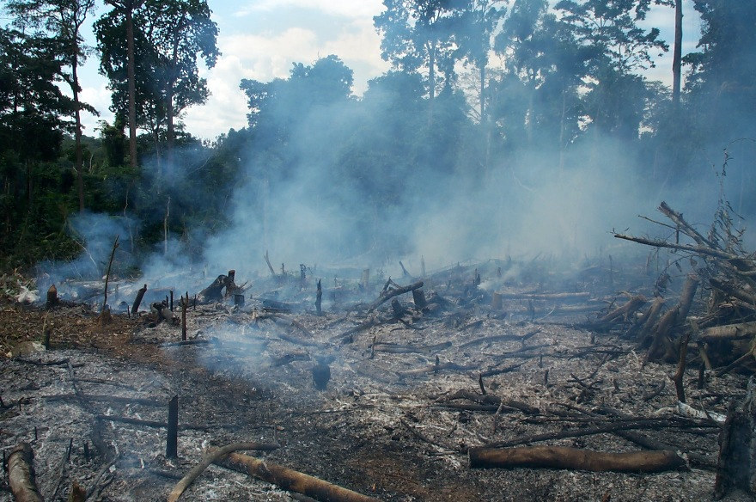
Project 1
Contribution tout sustainable farming in north-eastern Congo
Benoit Dheda
Didy Onautshu
Dieudonné Pyame
Joseph Adheka
Geert Baert
Geert Haesaert
Rony Swennen

Slide 2
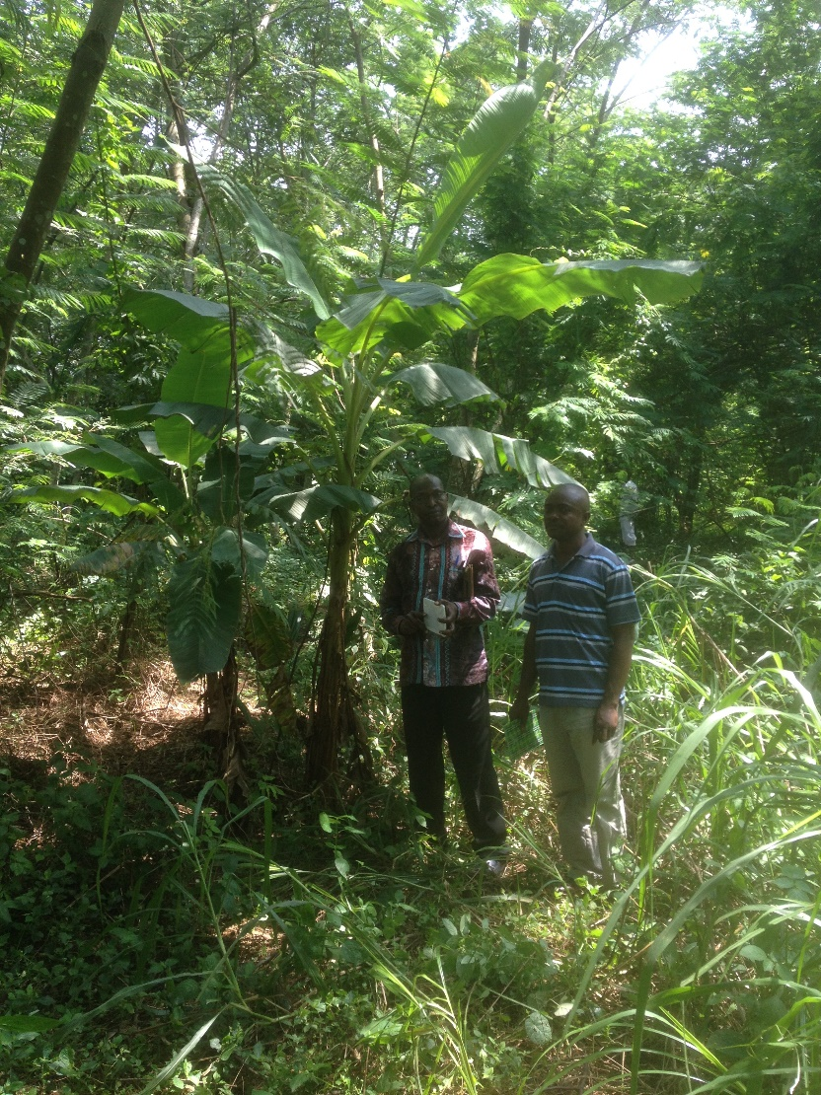
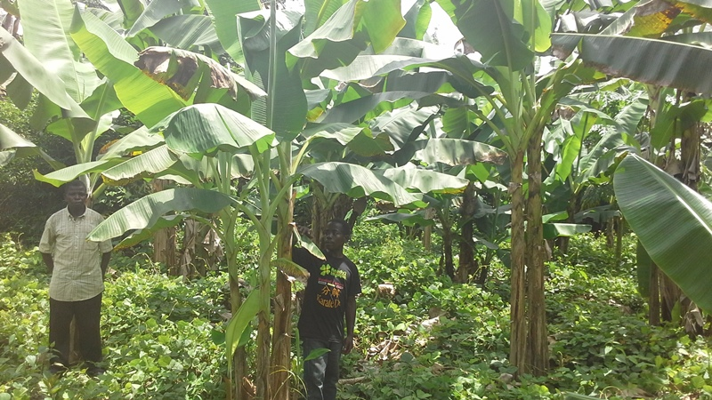
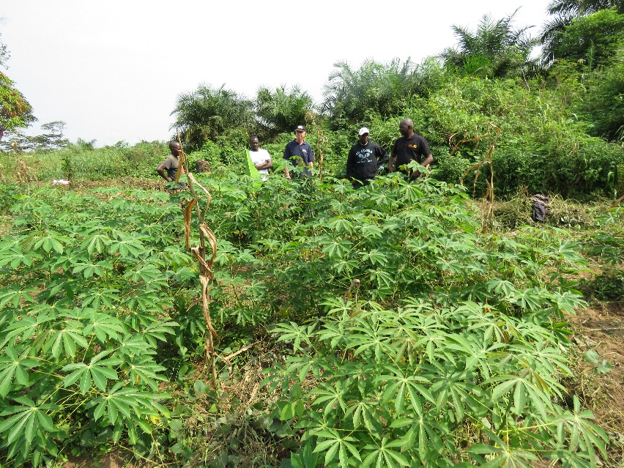
    Objective: develop sustainable farming
Healthy plants and improved varieties
Plant associations
Cover crops
Soil micro-organisms
Soil fertility

Slide 3
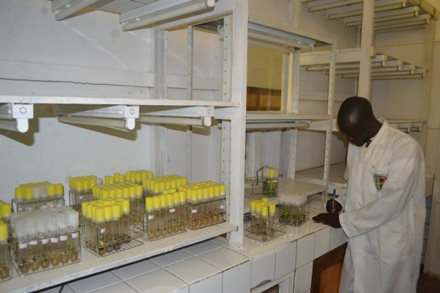
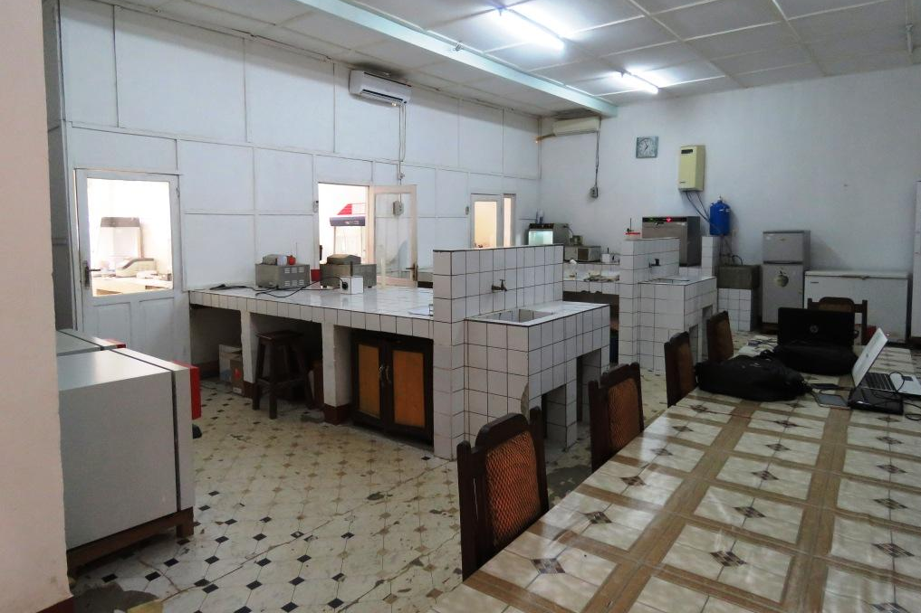
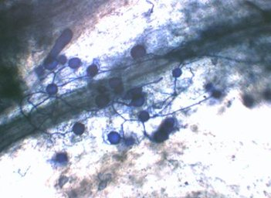
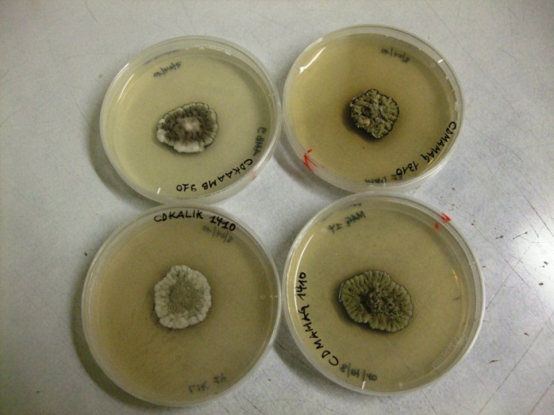
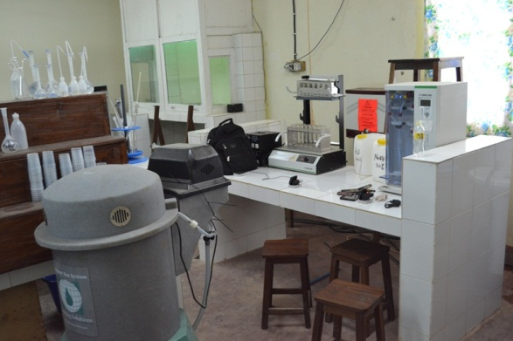
Achievements
Lab: in vitro culture
Lab: plant protection
Myccorhiza and other endophytes (Piriformospora sp.)
Paracercospora fijiensis
Lab: soil science

Slide 4
Impact and extension
Multiplication and distribution of plant material of food crops
Multiplication and distribution of agroforestery species
Demonstrations on animal husbandry
Field and lab days
Broadcasting on radio/TV with interaction with farmers
Capacity building (staff, farmers, NGOs, etc.)
Publications:
  International scientific journals
  Book « La culture des bananiers et plantains »
  Technical guidelines

