Slide 1
Forest monitoring in the Congo Basin
department of Green chemistry and technology/ Department of environment
research group Isotope bioscience laboratory (isofys)
Prof. Pascal Boeckx and Dr. Marijn Bauters
Notes:
You can maybe use a bit more I
PhD accomplishments in your presentation is a good thing, because it gives insight into your experience
Maybe relocate your PhD experience
Change the dark barground on the second slide
Keep me up at night only once
Tone and order of information
Too tentative : ‘ i feel ready for this’, ‘could be a guideline’, ‘gain basic knowledge vs really understand’
Structure: blankspot of central Africa
Was not a very clear transition into the workpackage, rework slide of WPs
Techniques why not refer to Vienna and FSU, maybe remove locations
Integrate ‘novelty’ and ‘me’ into the storyline instead of explicetly saying this ‘bingo card of criteria’.
Start with satellite image
Lost with the question, stronger answer…

Slide 2
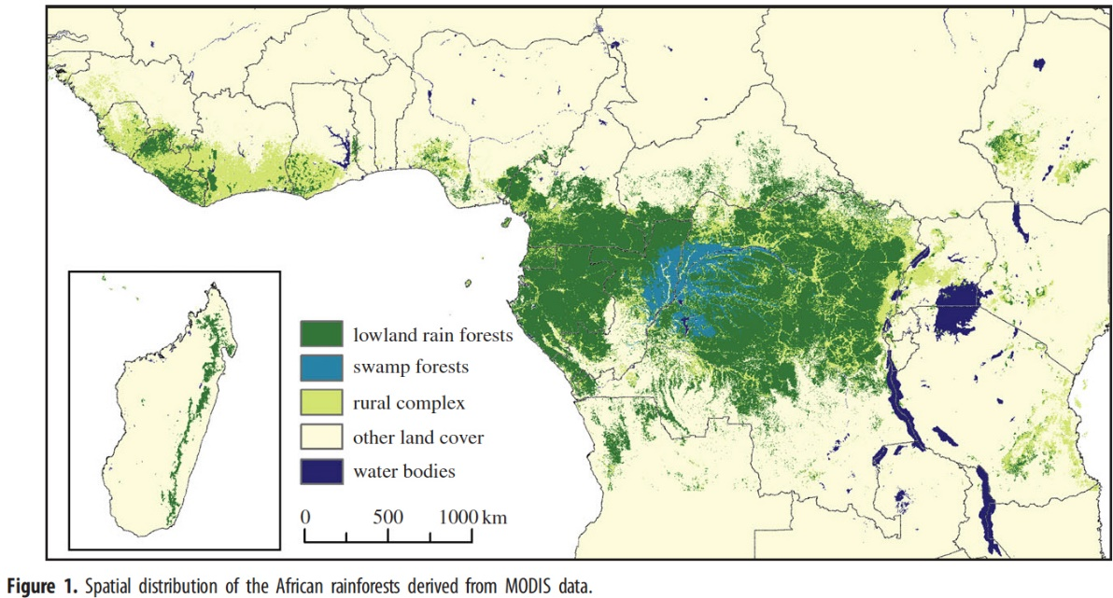
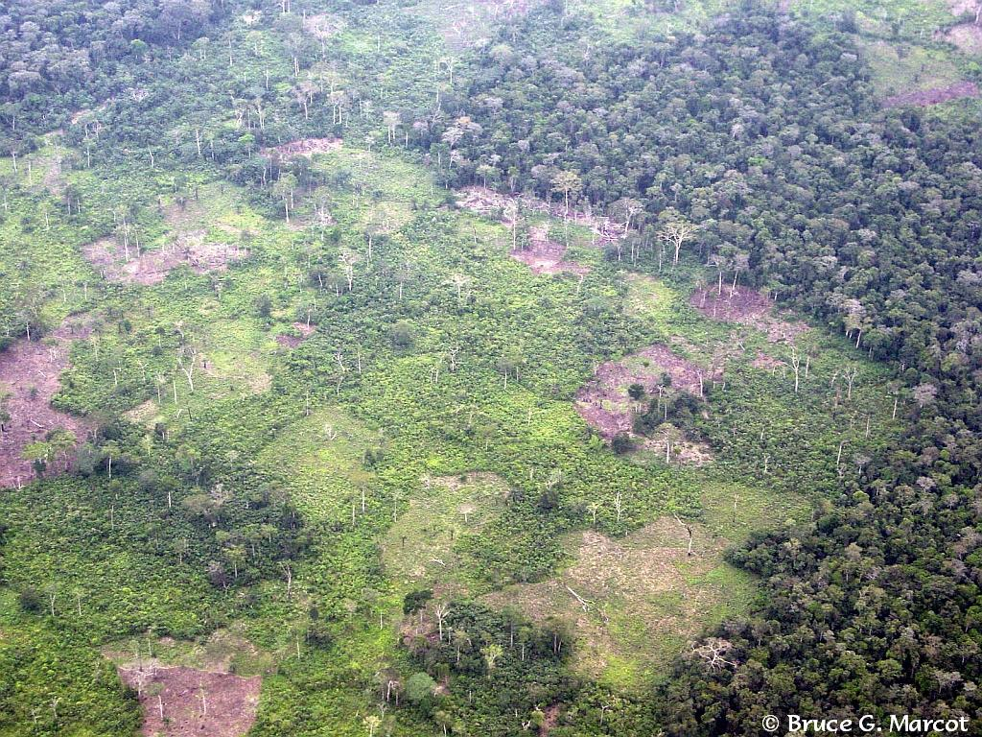
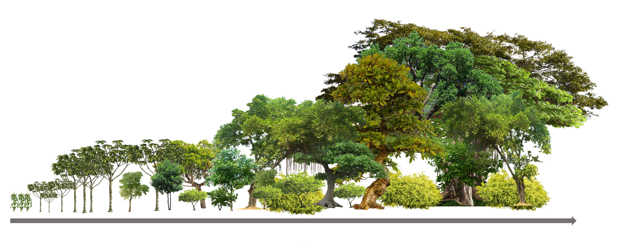
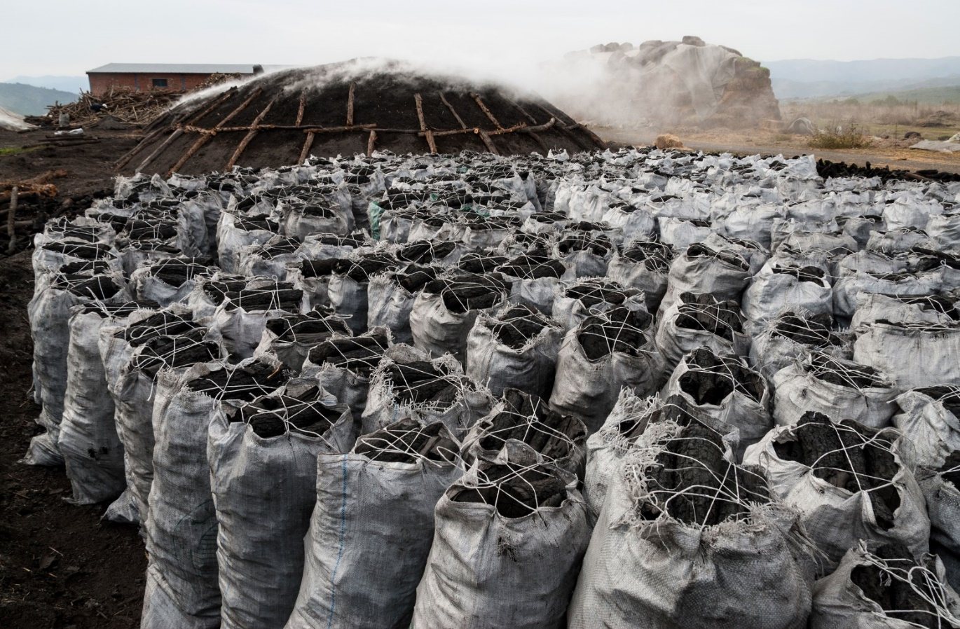
Gerland et al. 2014 Science
+400%
+15%
Time
AGC
SOC
BIODIVERSITY
~
finite resources
nutrients
Hansen et al. 2013 Science
Notes:
Snel focussen op studiegebied Congo Basin
Vermijden zuid-afrika vs mauretania

Slide 3
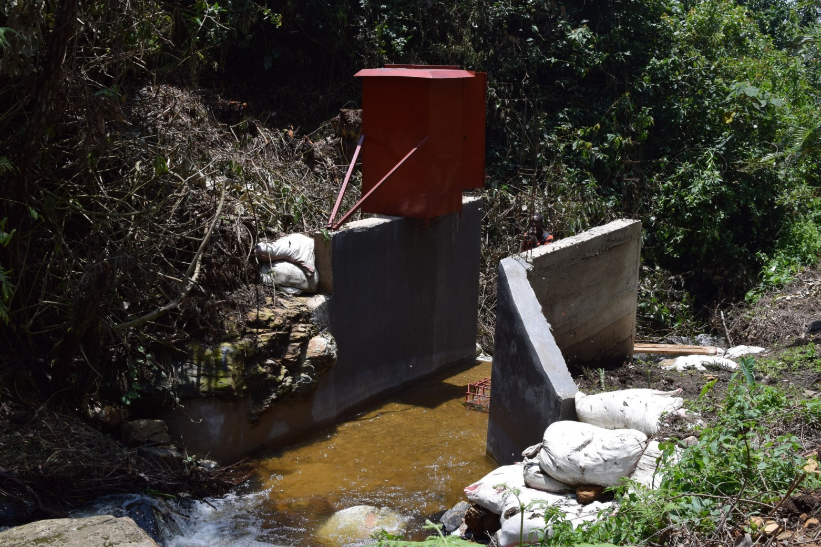
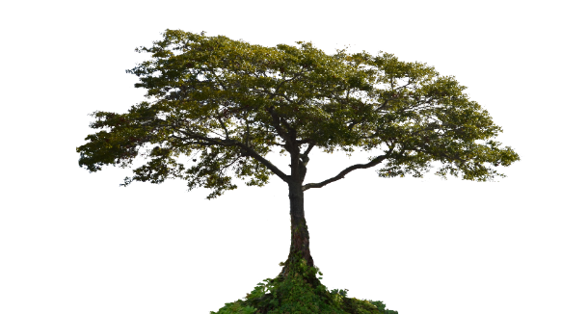
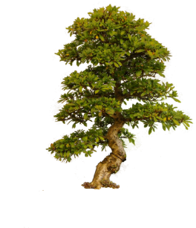
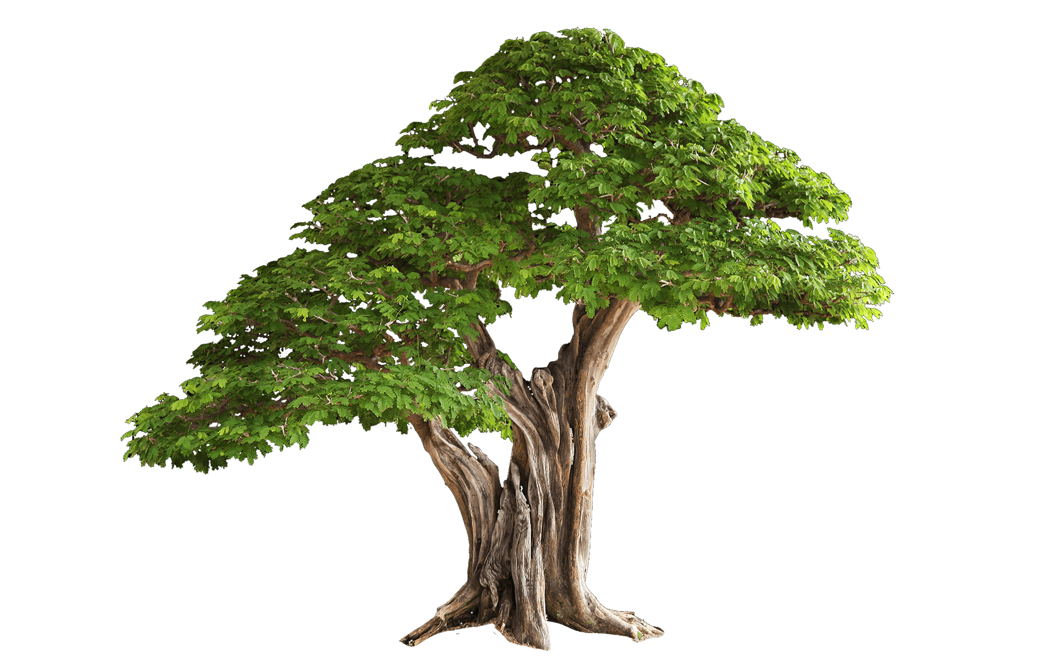
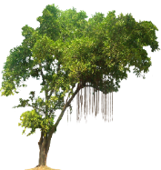
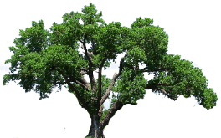
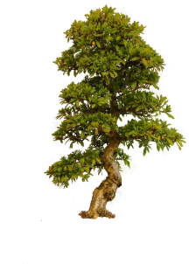
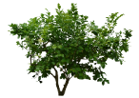
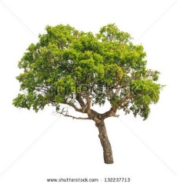
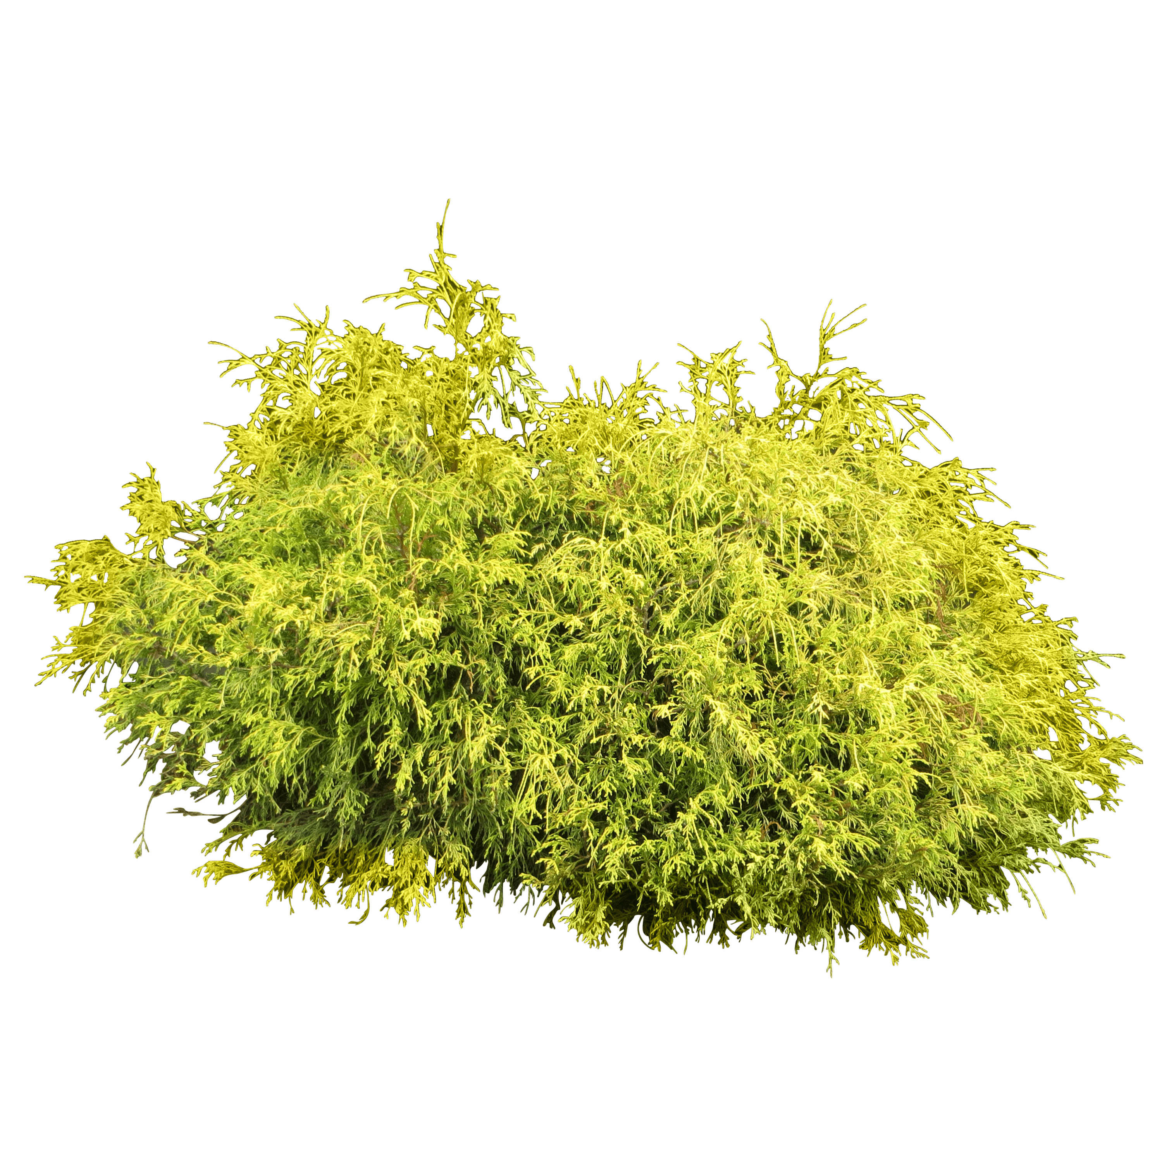
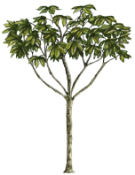
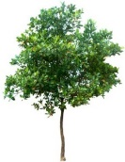
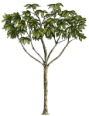
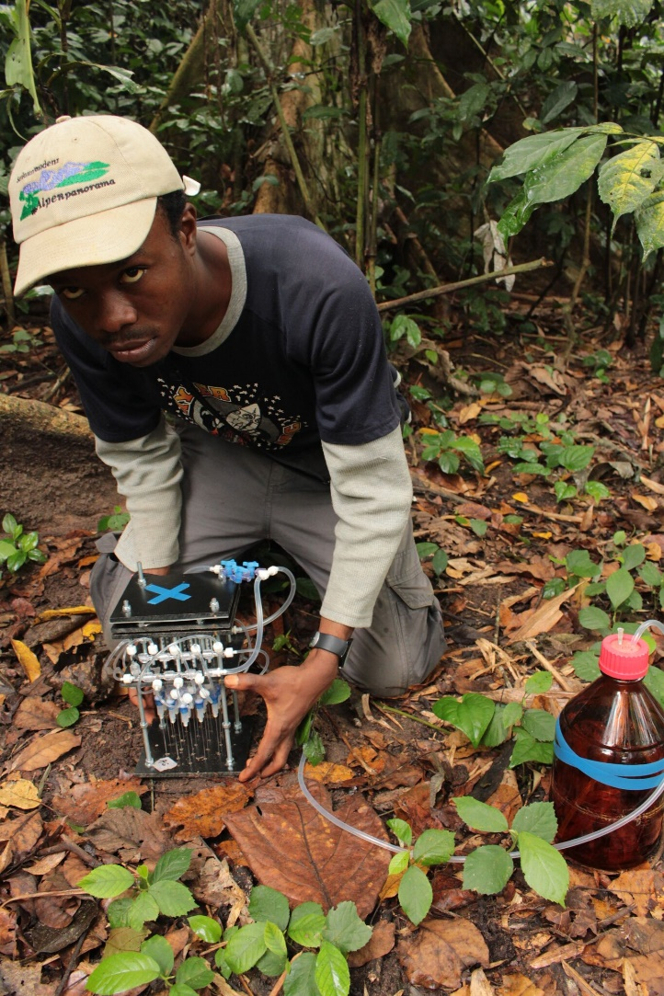
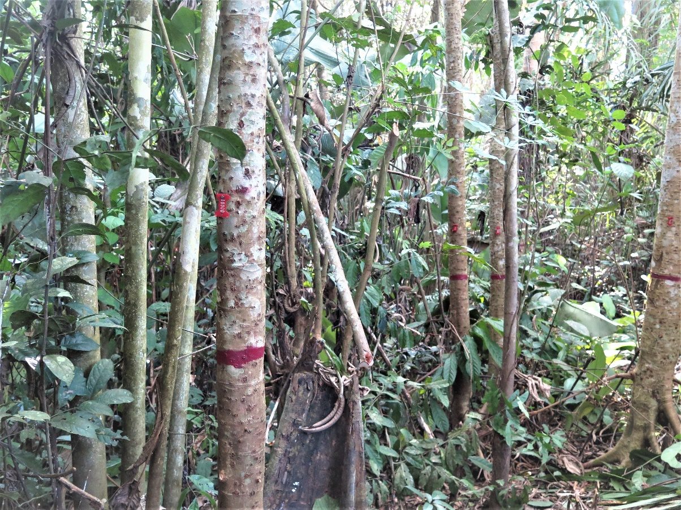
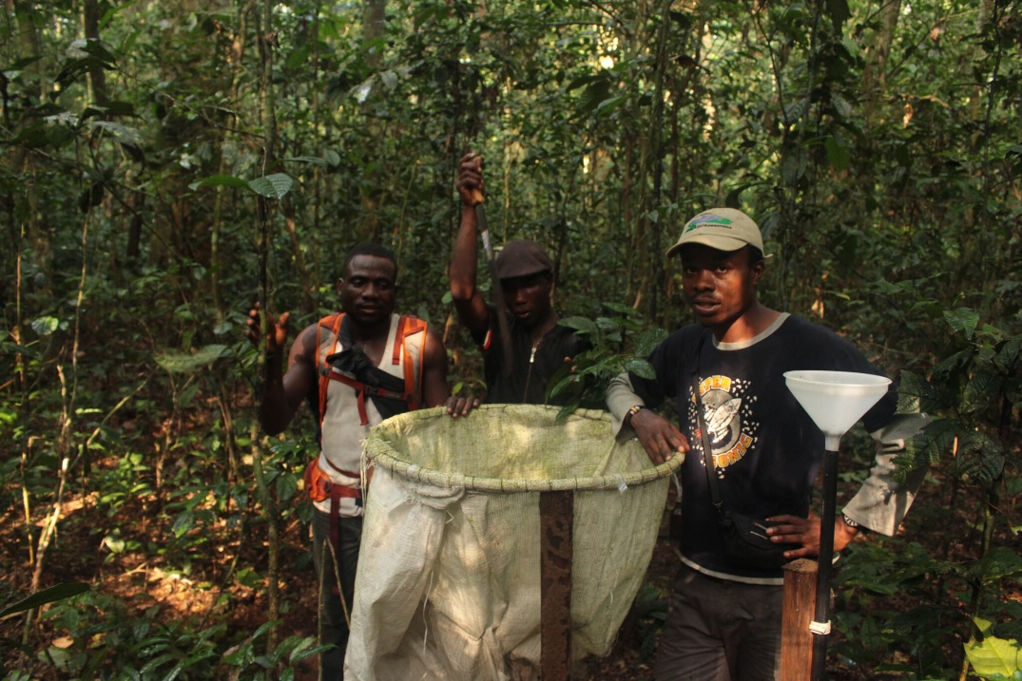
Time
Agriculture
6 yrs
12 yrs
20 yrs
60 yrs
input
stock increase
resorption
losses
Management history (# clearing cycles)
Integration and Synthesis
Management Guidelines
Policy brief
?
Notes:
Depositie langer blijven stilstaan
Pijlen laten verschijenen en meer depositie benadrukken.
Misshcien niet op as naar nul laten gaan
WP3 synthesis schrijven of voorstellen
Cassave 5 tot 10 ton
Tipping point

Slide 4
