Slide 1
Reducing climate risk
Paris Agreement implications for decarbonization
Dr. Michiel Schaeffer
Science Director, Climate Analytics

Slide 2
Content
Update on climate-change impacts & risks
Global emissions pathways compatible with Paris Agreement
NDC comparison across countries globally
EU and Member State pathways

Slide 3
Significant differences in impacts between 1.5°C and 2°C
Schleussner et al (2016)

Slide 4


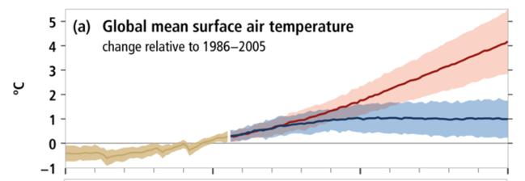
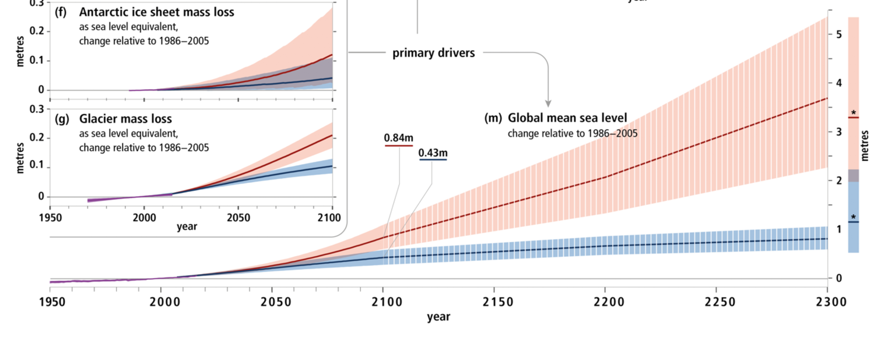
Sea level rise – Multiple meters is plausible
IPCC SROCC

Slide 5

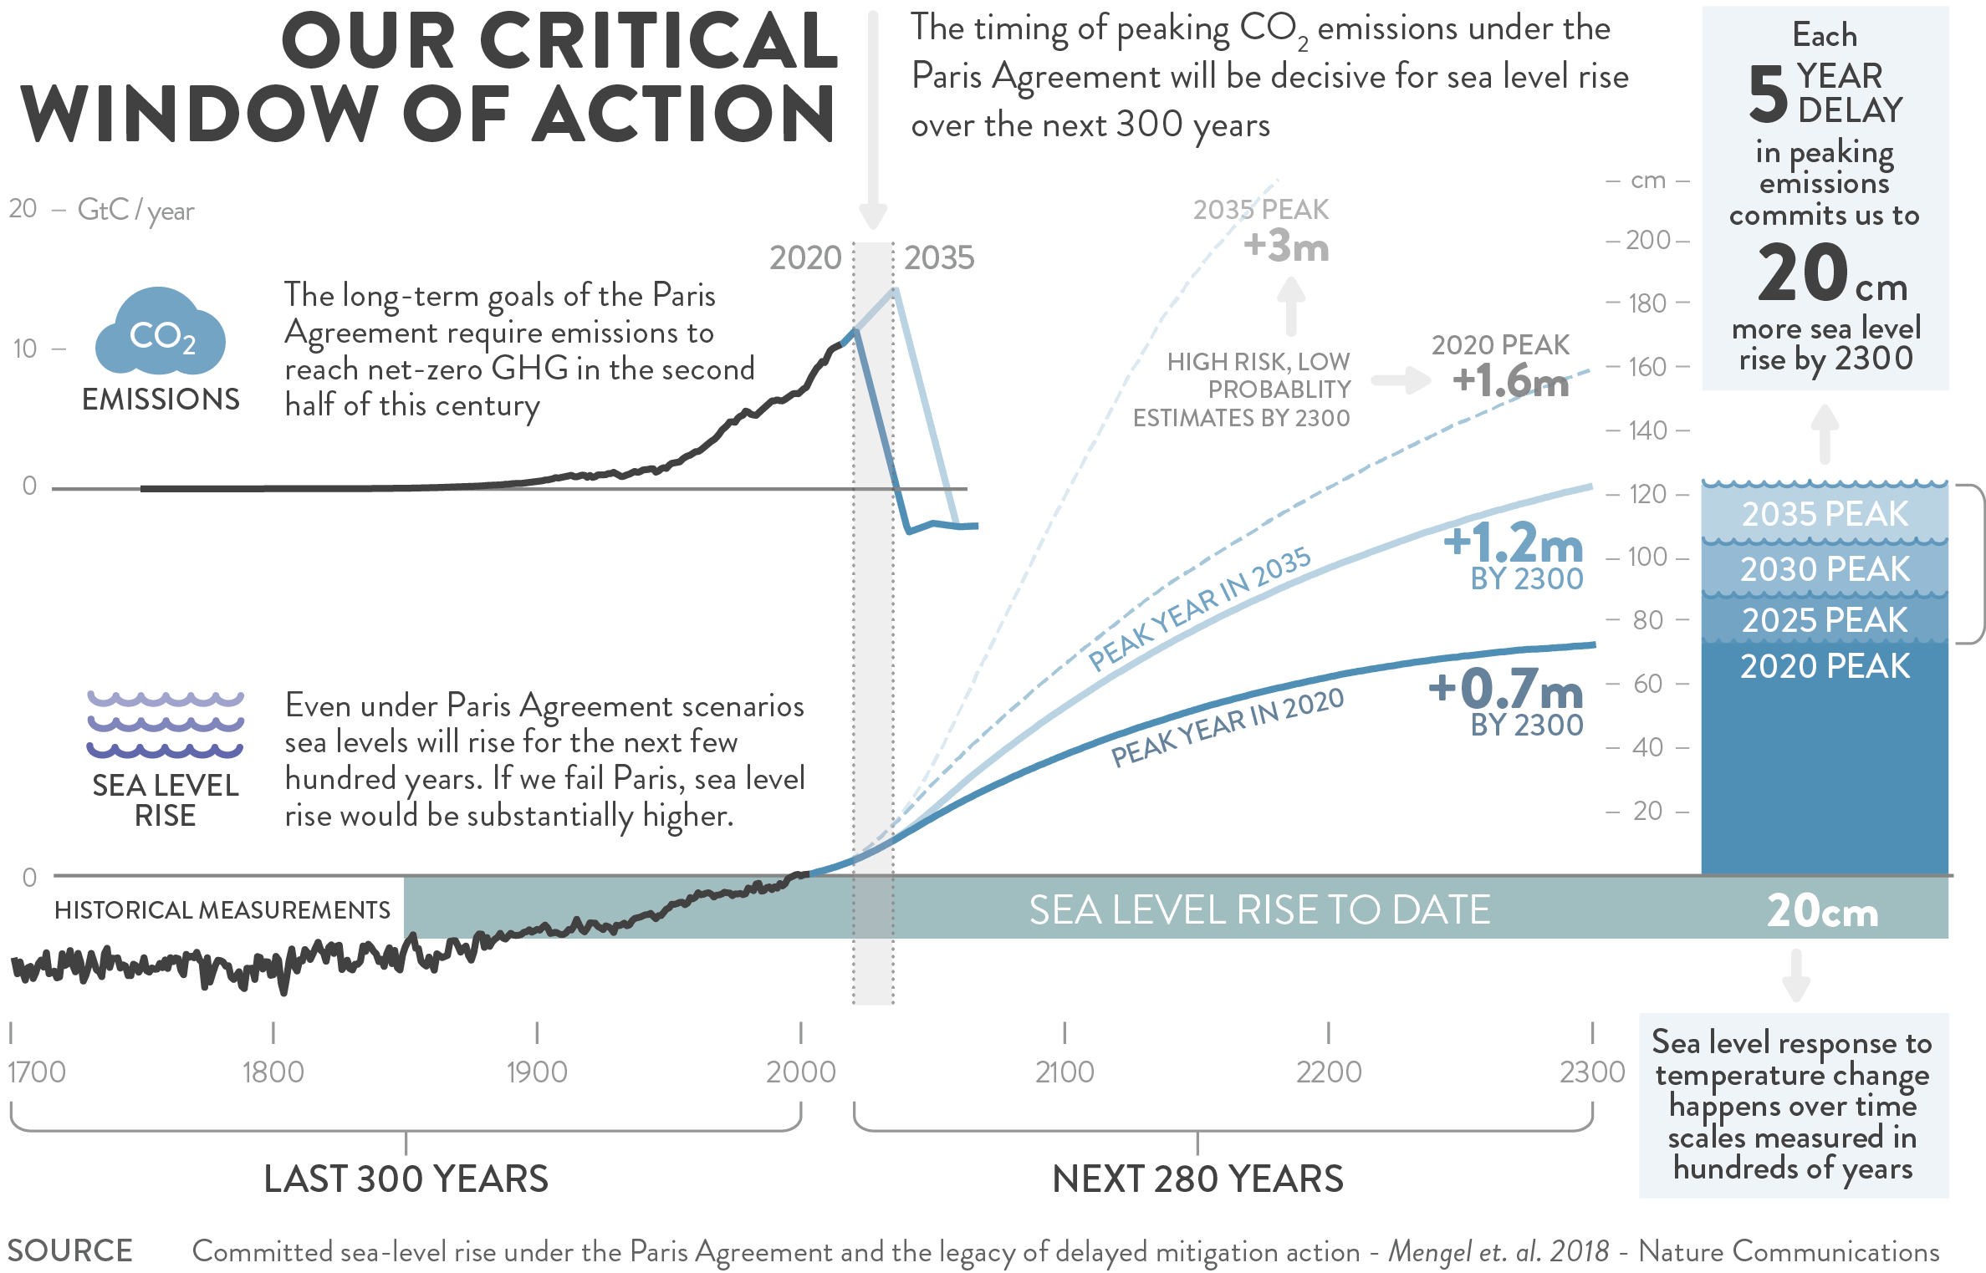
Sea level rise – our legacy for future generations
SEA LEVEL RISE

Slide 6
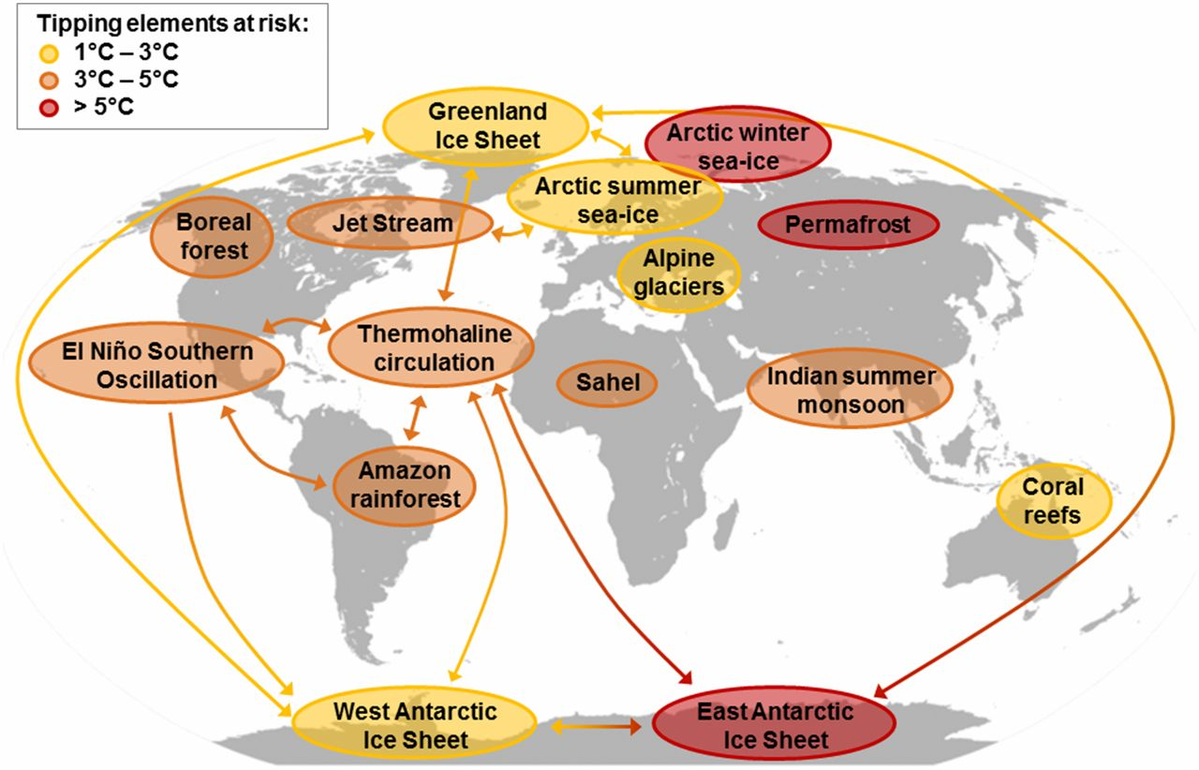
Tipping elements in the Earth system – the big unknowns that matter a lot
Tipping elements have the potential to trigger self-reinforcing feedbacks once a specific threshold is crossed, bringing unstoppable additional warming
Where these thresholds lie, however, is not well known
Steffen et al. (2018)
Notes:
tipping point behavior in which the feedback process becomes self-perpetuating after a critical threshold is crossed; subsystems exhibiting this behavior are often called “tipping el- ements”
Permafrost thawing → +0.1°C

Slide 7

Ocean acidification key threat for “calcifying” organisms (like corals, clams, mussels, sea urchins, barnacles and certain microscopic plankton)
Ocean acidification is a key threat for “calcifying” organisms, such as corals, clams, mussels, sea urchins, barnacles and certain microscopic plankton
Absorption of CO₂ from the atmosphere in the oceans leads to acidification (lower pH) and to growth inhibition, deteriorating health and at some point dissolving
Reductions in CO₂ emissions required to limit warming to 1.5ºC will lead to ocean acidification peaking and declining
Climate Analytics (2019)

Slide 8
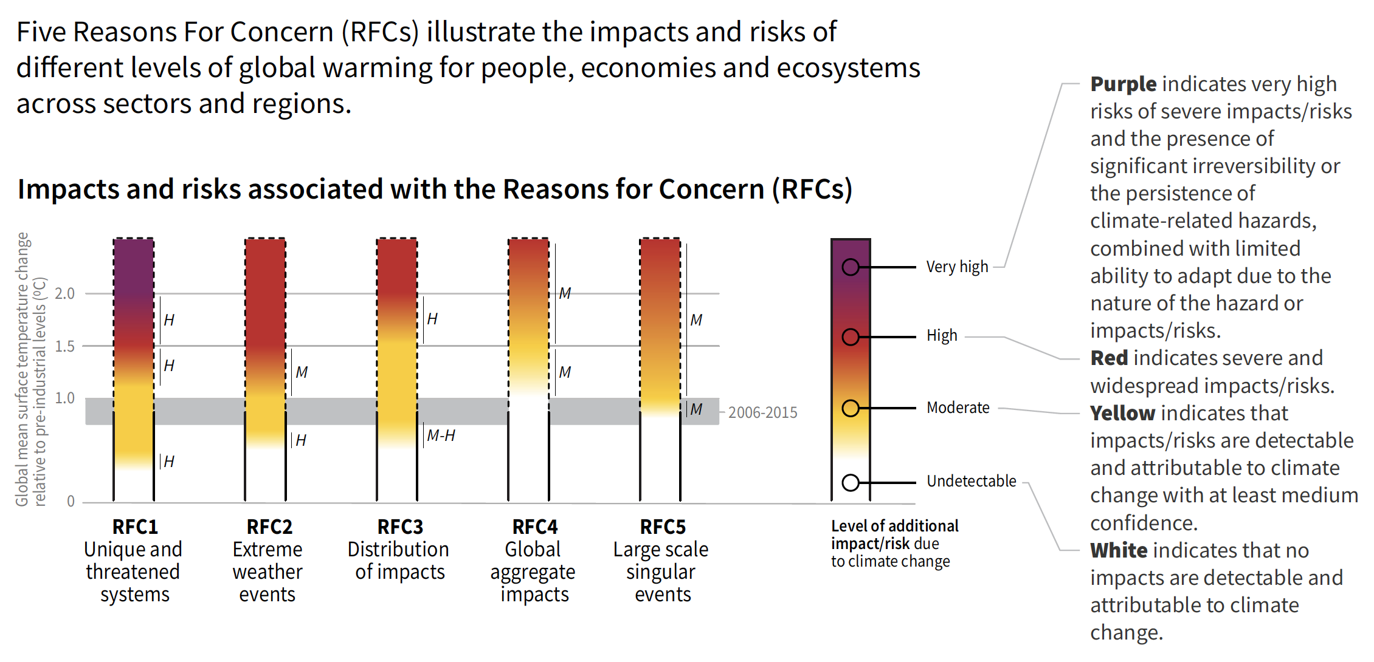
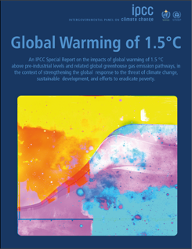
Reasons For Concern (RFC) – rapid increase with warming
IPCC SR1.5

Slide 9
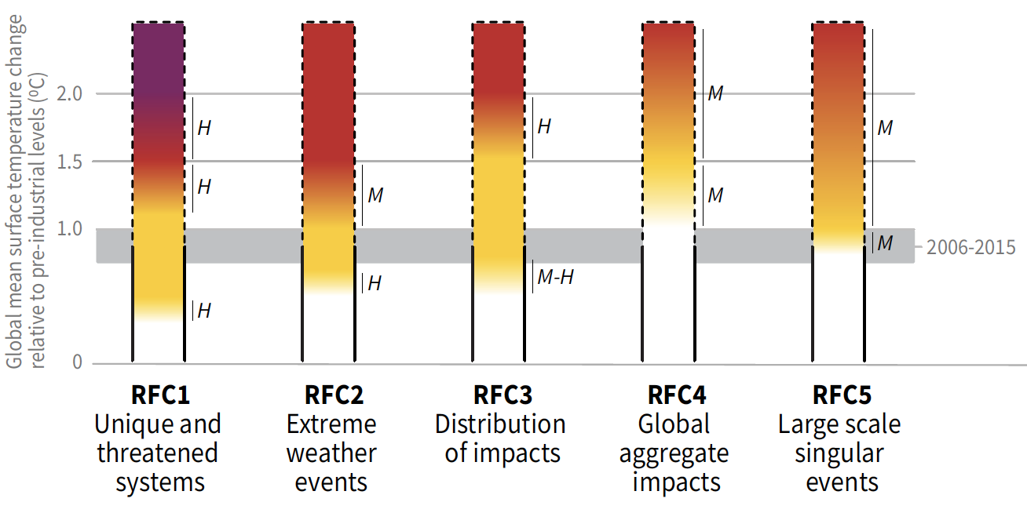
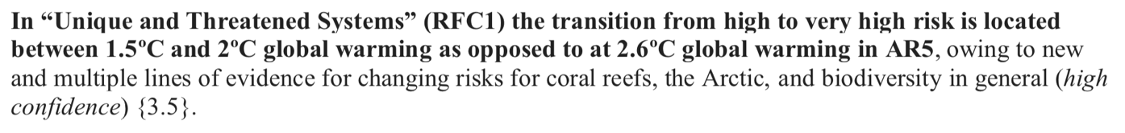
Reasons For Concern (RFC)
IPCC AR5 (2014) compared to SR1.5 (2018)
Four years of additional science: Risks are more severe and climate change is more dangerous than estimated earlier
2°C
1.5°C
2°C
1.5°C
IPCC AR5 & SR1.5

Slide 10
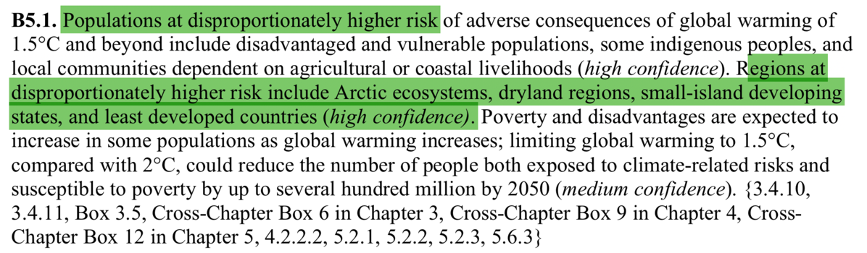

IMPACTS – vulnerable populations – very big difference between 1.5ºC and 2ºC
Limiting global warming to 1.5°C, compared with 2°C, could reduce the number of people both exposed to climate-related risks and susceptible to poverty by up to several hundred million by 2050 (medium confidence).
SIDS and communities dependent on coastal livelihoods at disproportionately higher risk
IPCC SR1.5

Slide 11
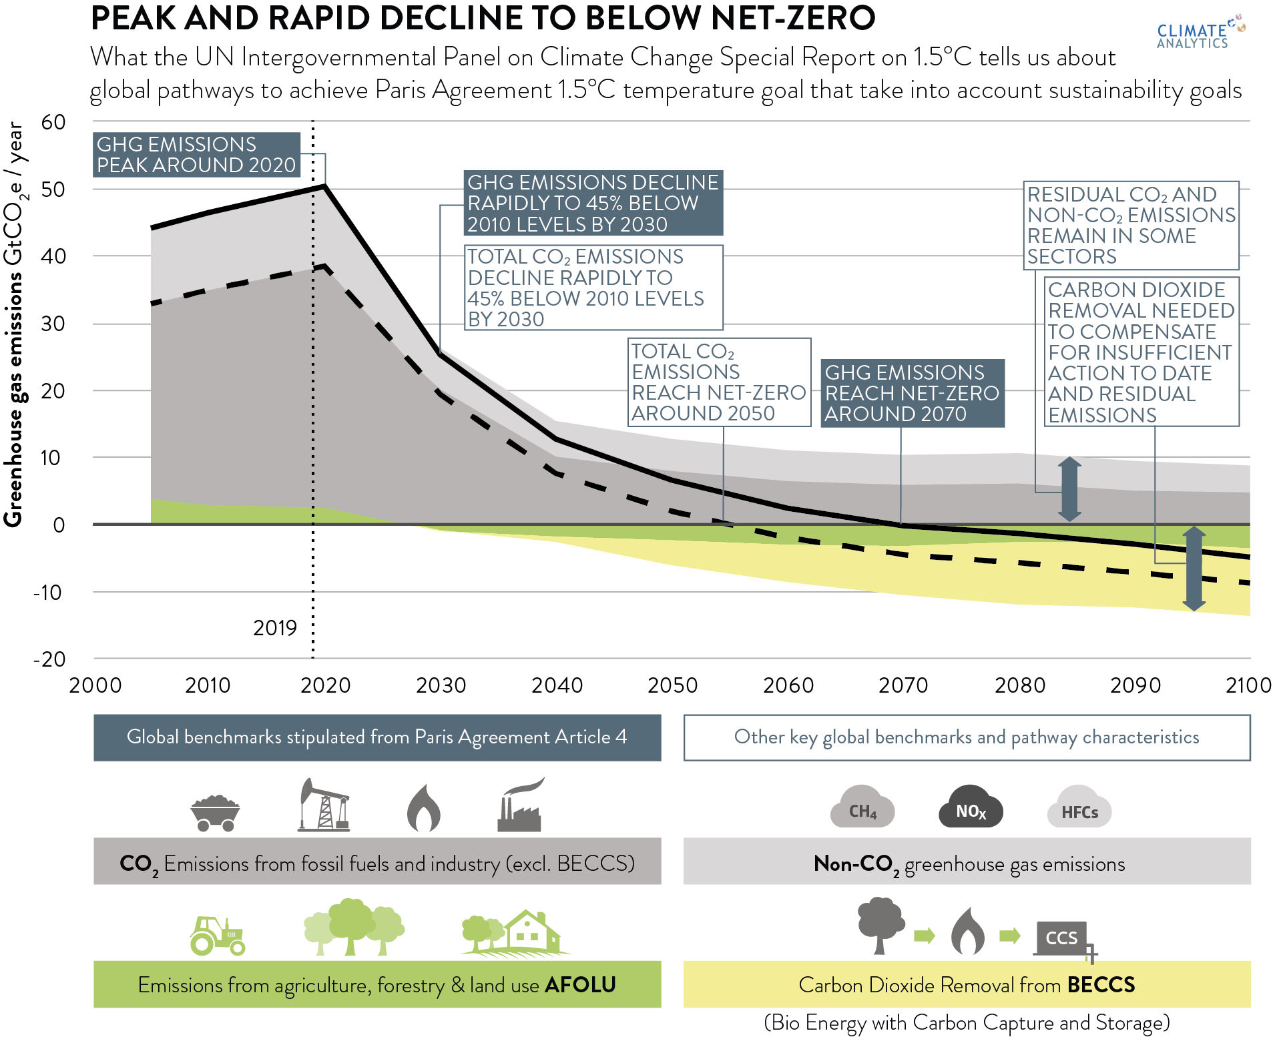
Paris Agreement Pathway Benchmarks in context of 1.5°C pathways in IPCC SR1.5
Source: Climate Analytics (2019); IPCC (2018)

Slide 12
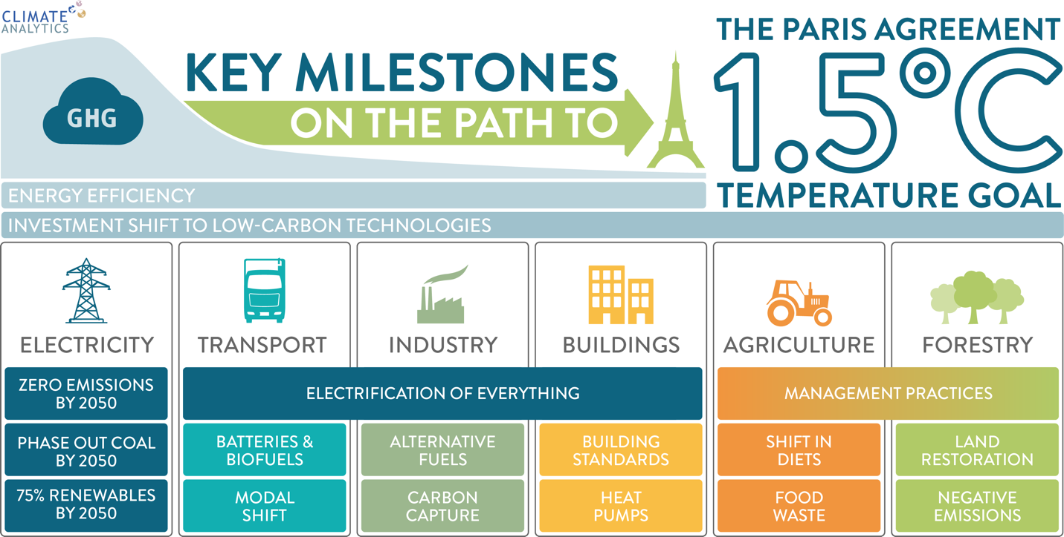








1.5°C transformation requires action in all sectors
ZERO EMISSIONS BEFORE 2050
NET ZERO CO₂
BY 2025-2040
PHASE OUT COAL BEFORE 2050
BATTERIES HYDROGEN
ELECTRICITY HYDROGEN
>75% RENEWABLES BY 2050
PRODUCT SUBSTITION, CCS
STOP DEFORESTATION PROTECT ECOSYSTEMS
With full transformation of energy-related sectors still strong push needed in land sectors
Investment in low-carbon energy technologies and energy efficiency needs to be increased by factor 6 by 2050 – Global annual investments in low-carbon energy technologies overtake fossil investments already by around 2025
Source: Climate Analytics (2019); IPCC (2018)

Slide 13
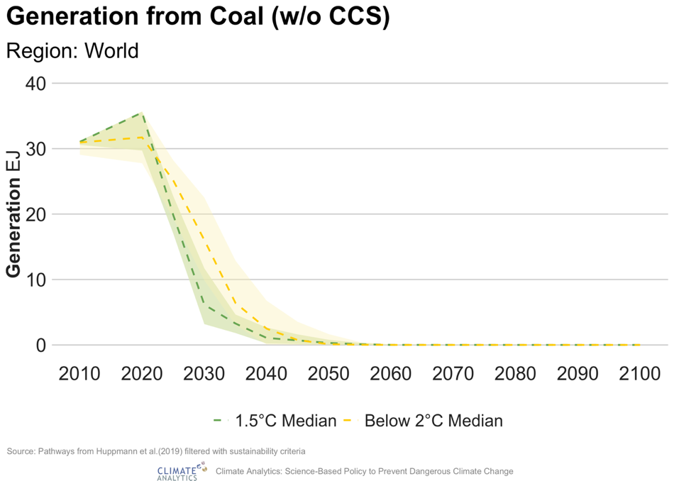
Economy-wide decarbonization must build on zero emissions power sector – but coal remains very large risk
Unabated coal in power sector needs to disappear globally by 2040
Planned additional coal capacity (MW)
Global Electricity Generation from Coal (w/o CCS)
in IPCC SR1.5 scenarios

Slide 14
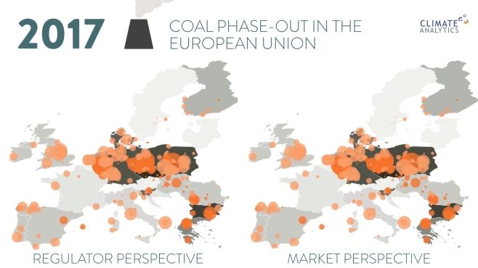
Movie: possible EU coal phase-out schedules
Source: Climate Analytics (2017)

Slide 15
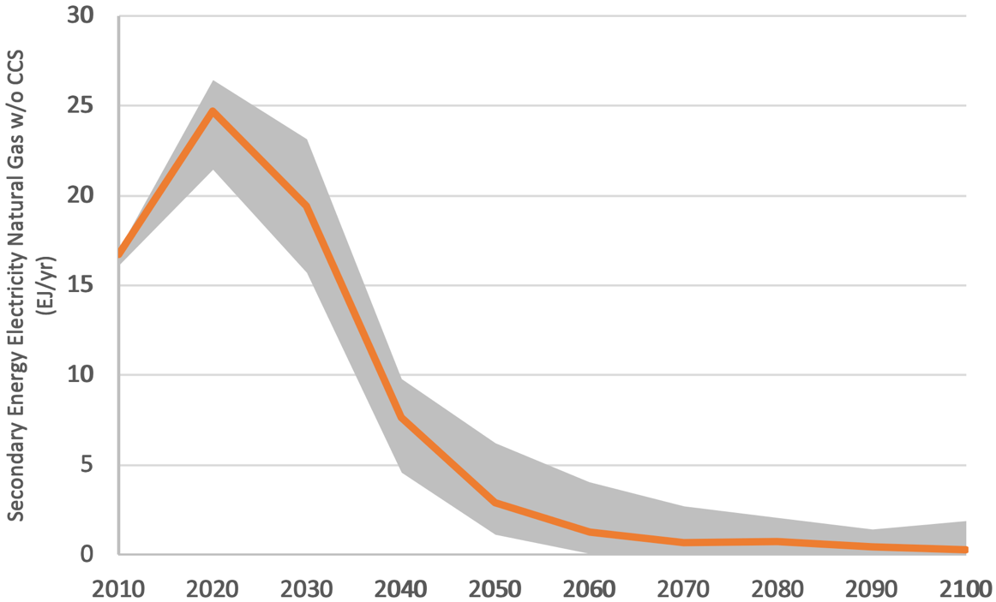
1.5°C pathways: natural gas for electricity generation will also need to be phased out
Natural gas (w/o CCS) in power sector is phased down rapidly
IPCC SR1.5 SPM explains that even with CCS the role of natural gas in the power sector would be limited to 8% by 2050
Median and 50% range of no- and limited OS 1.5°C pathways from public IPCC SR1.5 scenario database
Source: Climate Analytics (2019)
Notes:
- Electricity generation from natural gas without CCS. Shown are the median for PAcompatible
IAMs, with interquartile range (dashed lines), as well as the results from the IEA ETP B2DS,
both for the ASIA region.

Slide 16
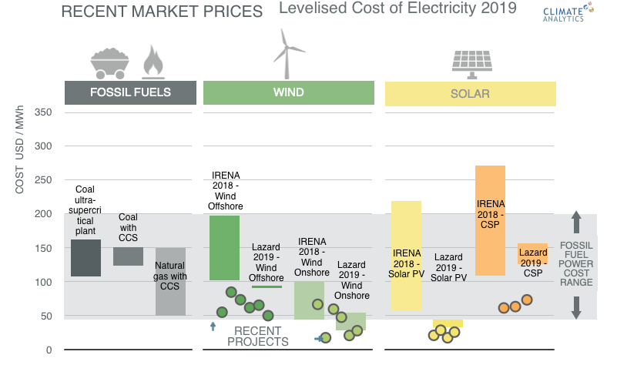
Large potential to speed up action in the power sector
Renewable energy technologies are cost-competitive with new fossil fuel plants and large parts of the operating fleet in many places
Source: Climate Analytics compilation based on Lazard‘s Levelized Cost of Energy Analysis, Version 12, IRENA‘s Renewable Power Generation Costs in 2018, and numerous sources for individual recent projects

Slide 17
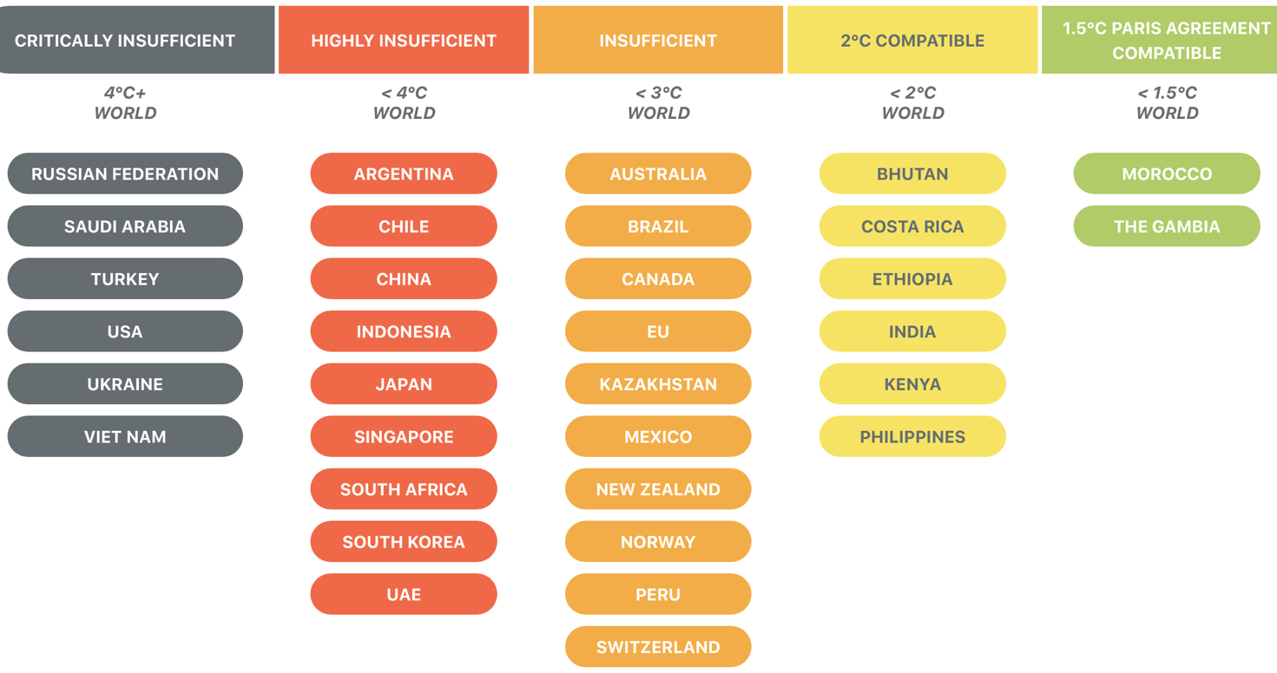
NDCs of vast majority of countries not in line with Paris Agreement
Individual countries: vast majority of countries has targets insufficient to achieve PA goals
Climate Action Tracker projection: 2.8°C warming by 2100
(Analysis December 2019)

Slide 18
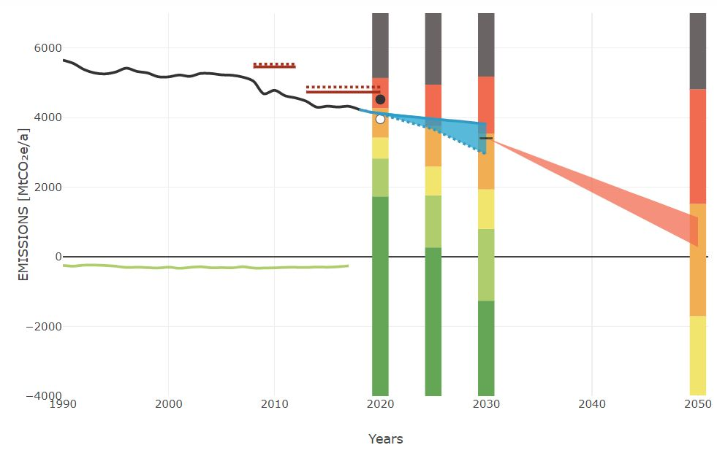
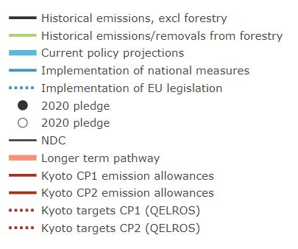
Paris Agreement Pathways for the EU
Climate Action Tracker Assessment (equity ranges)
Source: Climate Action Tracker (2019); Climate Analytics (2019)

Slide 19
Paris Agreement Pathways for the EU
Climate Action Tracker Assessment (equity ranges)
1.5°C pathway with lower reliance on global Carbon Dioxide Removal in land sector
Source: Climate Action Tracker (2019); Climate Analytics (2019)

Slide 20
Paris Agreement Pathways for the EU
Climate Action Tracker Assessment (equity ranges)
1.5°C pathway with global Carbon Dioxide Removal in land sector at very-high end of sustainable/technical/economic potential by 2050
Source: Climate Action Tracker (2019); Climate Analytics (2019)

Slide 21
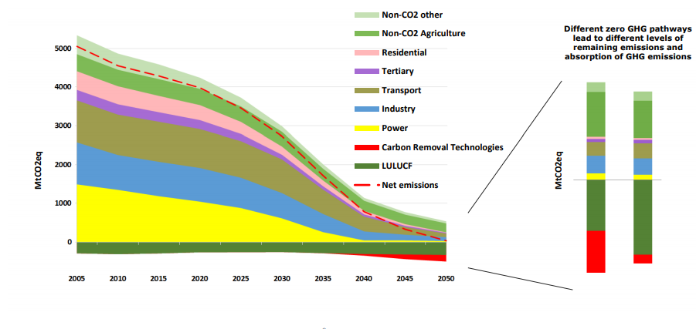
How the EU gets to zero emissions matters…
(red dotted line includes LULUCF)
Scenario 1.5LIFE
1.5
TECH
1.5
LIFE
Source: European Commission’s Communication

Slide 22
Paris Agreement Pathways for the EU
Climate Action Tracker Assessment (equity ranges)
Scenario 1.5LIFE
(excl. LULUCF)
Source: Climate Action Tracker (2019); Climate Analytics (2019)

Slide 23
Co-benefits of scaling up action in the EU
EU opportunities in renewable energy sector

Slide 24
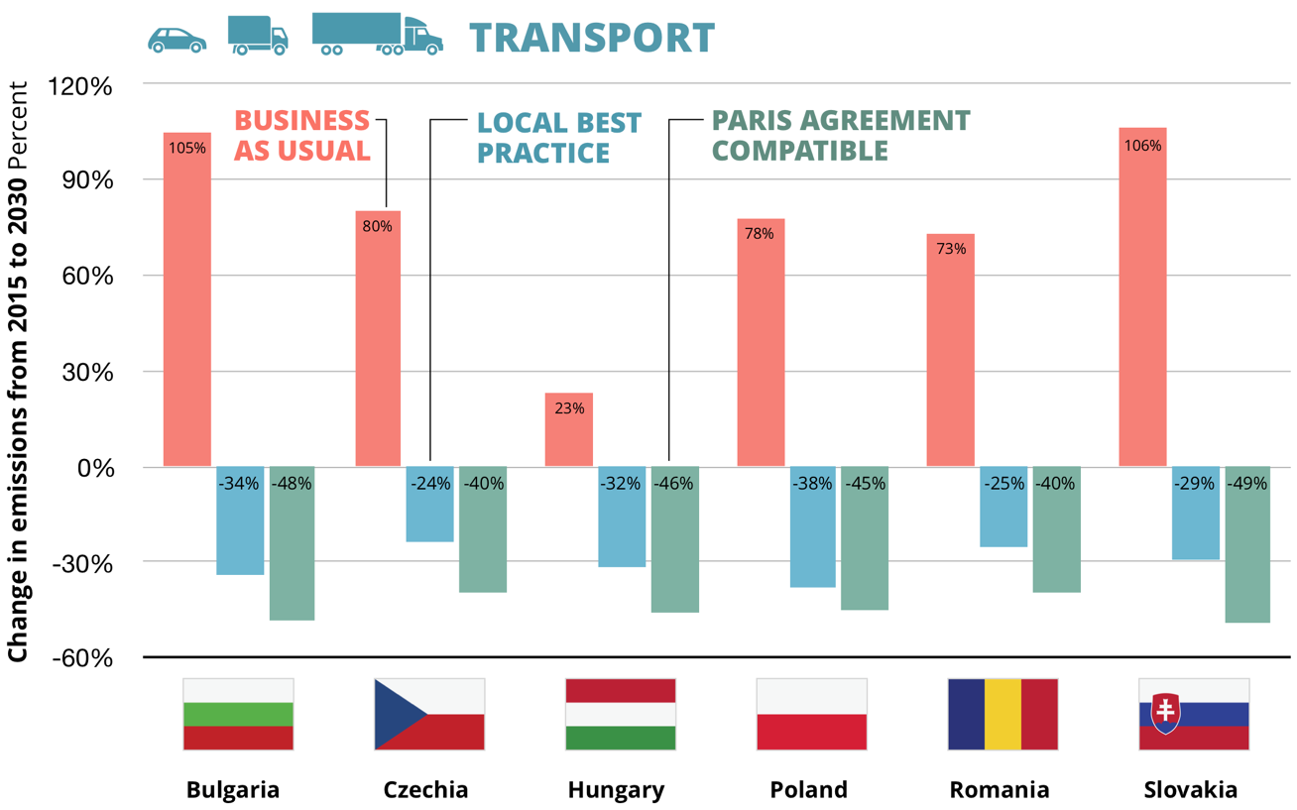
Emissions reductions in transport
Climate Analytics‘ report „Between Best Practices in the transport sector and Paris Agreement compatibility“ published in the framework of Project „CEE Climate Policy Frontier“ funded by GIZ‘s European Climate initiative – publication pending
Notes:
Emissions reduction to achieve PA challenging but not impossible.
There is a gap of between 7 and 20%-points between PA and Best Practice scenario in the transport sector.
Especially Slovakia will have to change its trends from an increase in emissions intensity to a decrease by at least 1.2% annually (Best Practice)

Slide 25
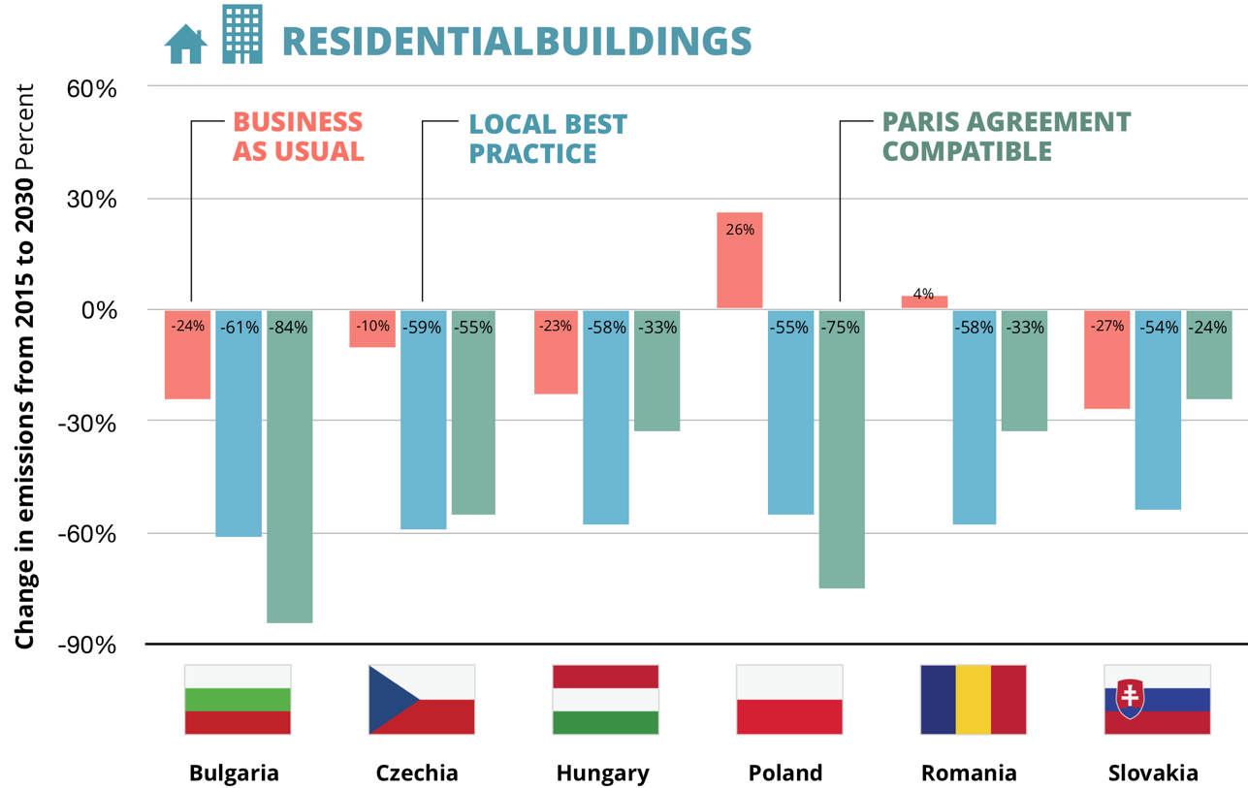
Emissions reductions in the buildings sector
Climate Analytics‘ report „Between Best Practices in the transport sector and Paris Agreement compatibility“ published in the framework of Project „CEE Climate Policy Frontier“ funded by GIZ‘s European Climate initiative – publication pending
Notes:
The emissions reduction for PA for buildings is even more challenging than for transport with emissions reduction by between 24% and 84% below 2015 levels.
But in this case best practices could allow some countries to even go beyond what‘s needed for PA.
This concerns especially Slovakia, which is already reduced ist emissions significantly between 2000 and 2015, especially by halving its energy intensity. A continuation of this trend will allow it to exceed PA limits

Slide 26

Thank you. Questions?

